Slide 1


Introduction to Side-Channel Analysis
Department of Electrical Engineering
Jiun-Peng CHEN Oct. 13, 2023

Slide 2
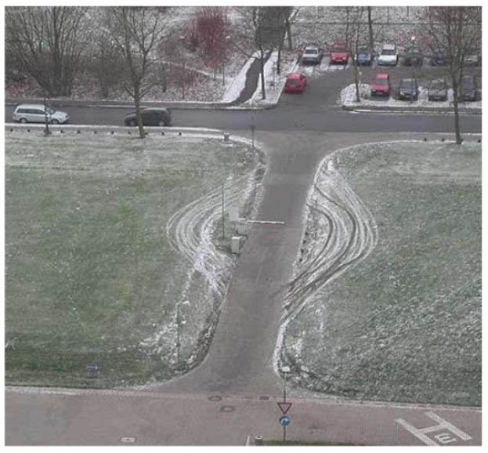
Side-Channel Analysis (Attack)
extra source of information
Notes:
那以這張圖來說，旁通道分析就像是車輛不經過這閘門，從旁邊繞到過去。 其實我這邊顏色有對應，紅色就像是要分系破解，可以需要暴力破解或有金鑰。可想像車輛藉由綠色的草坪，繞過紅色閘門答到目的。 以這張圖來說，就是繞過去不用付錢。

Slide 3

Side-Channel Analysis (Attack)
In cryptography, a Side-Channel Analysis is any attack based on information gained from the physical implementation of a cryptosystem rather than brute force or theoretical weaknesses in the algorithms (compare cryptanalysis).
For example, timing information, power consumption, electromagnetic leaks, or even sound can provide an additional source of information, which can be exploited to break the system.
Paul Kocher 1973-
https://en.wikipedia.org/wiki/Side-channel_attack
https://en.wikipedia.org/wiki/Paul_Carl_Kocher

Slide 4


Slide 5


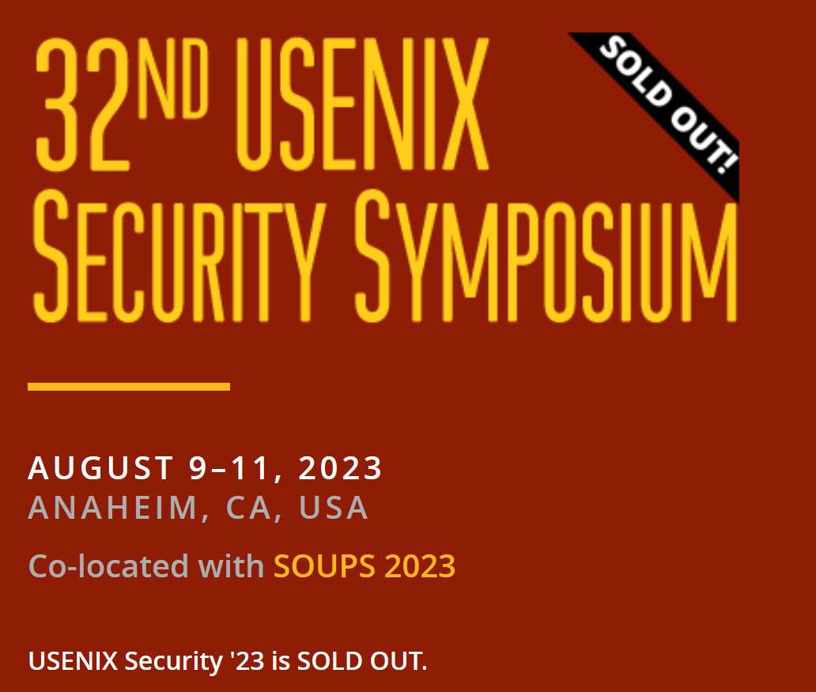

2022 The ACM Conference on Computer and Communications Security (CCS)
IACR Transactions on Cryptographic Hardware and Embedded Systems (TCHES)

Slide 6


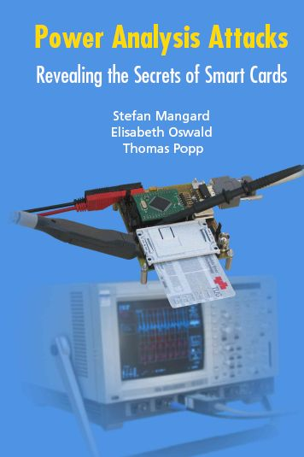

Power Analysis Attacks (Ch. 1-3, 6)
Graz University of Technology, Austria
Stefan Mangard,
Thomas Popp
University of Bristol, UK
Elisabeth Oswald,
https://link.springer.com/book/10.1007/978-0-387-38162-6
http://dpabook.iaik.tugraz.at/

Slide 7
Outline
Introduction
Cryptographic Devices
Power Consumption
Research Papers
Advanced Encryption Standard
Power Analysis and Countermeasure
Conclusion

Slide 8
1. Introduction
Cryptographic Algorithms
Attacks on Cryptographic Devices
Power Analysis Attacks
Countermeasures Against Power Analysis Attack

Slide 9
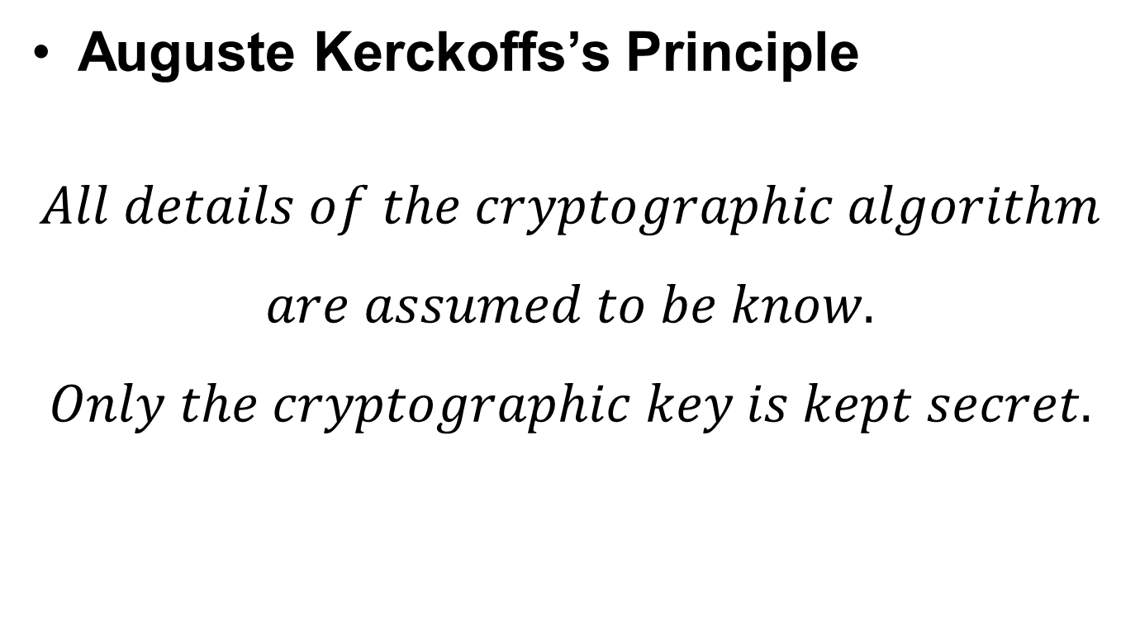
Cryptographic Algorithms
Auguste Kerckoffs’s Principle
$$All details of the cryptographic algorithm$$
$$are assumed to be know.$$
$$Only the cryptographic key is kept secret.$$

Slide 10
Modern Cryptography (1976-)
Symmetric-key cryptography
Uses the same cryptographic keys for both plaintext encryptions and ciphertext decryption.
DES, AES (Advanced Encryption Standard)
Differential Power Analysis, DPA (1999) 2023/10/12 Times Cited: 10508
Lightweight Cryptography (2023: ASCON)
Public-key cryptography
Uses key pairs: public keys and private keys.
RSA, ECC (Elliptic Curve Cryptography)
Simple Power Analysis, SPA (1996) 2023/10/12 Times Cited: 6716
Post-Quantum Cryptography (2022: Kyber, Dilithium, and SPHINCS⁺)

Slide 11
Attacks on Cryptographic Devices
Cache Attack
Invasive
Active
(Fault Injection)
Semi-invasive
Passive
Non-invasive
Tamper the context or not
The Degree of de-packaging

Slide 12
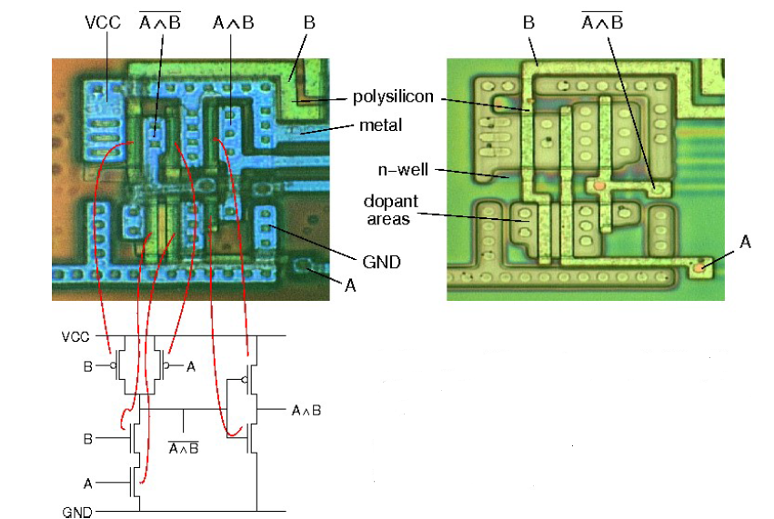
Invasive and Semi-invasive

Slide 13
Attacks on Cryptographic Devices
Side-Channel Analysis:
Cache Attack
Invasive
Active
(Fault Injection)
Semi-invasive
Passive
Non-invasive
Tamper the context or not
The Degree of de-packaging

Slide 14
Power Analysis Attacks
Power Consumption
Data-Dependency
Operation-Dependency
Simple Power Analysis
Just a few power trace
Differential Power Analysis
More power traces

Slide 15
Countermeasures
Goal
Remove the dependency of intermediate values
Hiding
Remove data-dependency
Cannot be removed completely
Masking
Randomize intermediate values
Can still be data-dependent
Session Keys
Key should be updated as frequently as possible

Slide 16
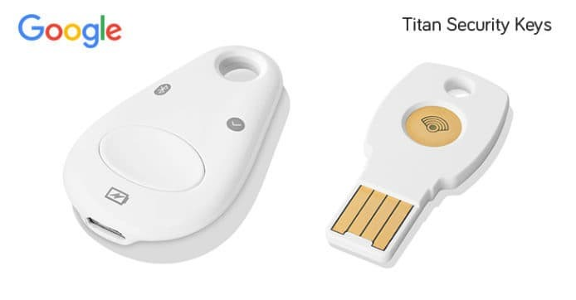
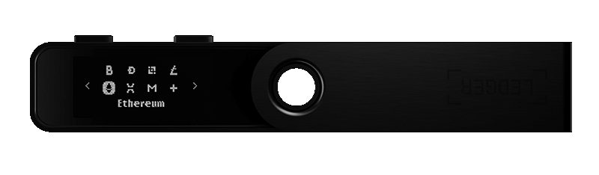
2. Cryptographic Devices
Cryptographic Devices
Implement algorithms and store keys
Smart card, USB token, RFID tag, etc.
Security
Should not rely on the secrecy of the implementation
https://shop.ledger.com/pages/ledger-nano-s-plus
https://store.google.com/us/product/titan_security_key?hl=en-US

Slide 17
Components
Dedicated Cryptographic Hardware
General-Purpose Hardware
Cryptographic Software
Memory
Interface

Slide 18
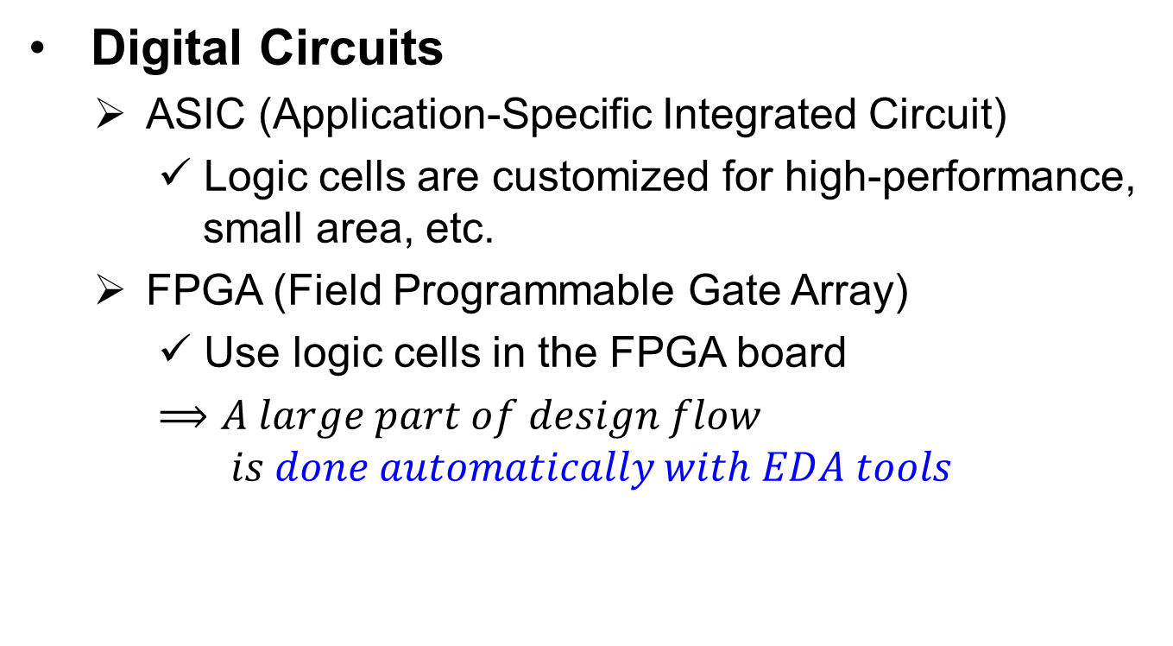
Design and Implementation
Digital Circuits
ASIC (Application-Specific Integrated Circuit)
Logic cells are customized for high-performance, small area, etc.
FPGA (Field Programmable Gate Array)
Use logic cells in the FPGA board
$⟹A large part of design flow$
$$is done automatically with EDA tools$$

Slide 19
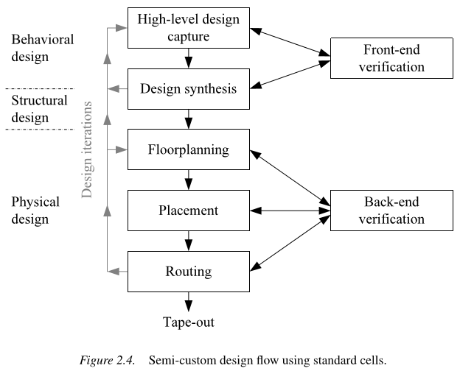
Custom Design
Design Steps
Specification
Behavioral Design
Structural Design
Physical Design
ASIC
FPGA

Slide 20
Logic Cells
2-input CMOS NOR Gate
2-input CMOS NAND Gate
Type:
Combinational Cells
Sequential Cells
Complementary CMOS Logic Style
A Logic cell consists of:
a Pull-up Network (PUN) (composed of PMOSs)
a Pull-down Network (PDN) (composed of NMOSs)
A. S. Sedra, K. C. Smith, T. C. Carusone, V. Gaudet, Microelectronic Circuits, 7th ed. Oxford University Press, 2020

Slide 21
3. Power Consumption
Static power consumption:
PUN/PDN does not conduct simultaneously.
Leakage current (quite small)
Dynamic power consumption:
Lumped-C model:
Intrinsic & extrinsic capacitance
Lumped together in to a single capacitance
Dynamic Power >> Static Power
Data dependency
Charging Current
Short-circuit current
0
-> 1
-> 0
1
-> 0
-> 1
Discharging current
A. S. Sedra, K. C. Smith, T. C. Carusone, V. Gaudet, Microelectronic Circuits, 7th ed. Oxford University Press, 2020

Slide 22
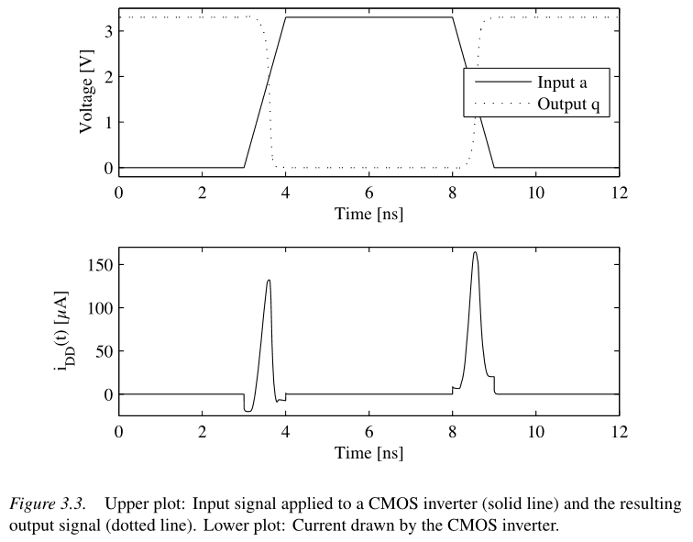
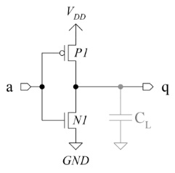
Dynamic Power Consumption
S. Mangard, E. Oswald, and T. Popp, Power Analysis Attacks: Revealing the Secrets of Smart Cards. New York, NY, USA: Springer, 2006

Slide 23
Models
Hamming Distance (HD) model
Map transitions to power consumption values
Buses and registers
Hamming Weight (HW) model
The more bits are set to the same value the better
Only resort to HW model if HD model cannot be applied
Other Models
Different weights for different types of transitions
Power consumption of larger parts of a circuit

Slide 24
Software Power Model
Data transferred between memory and CPU
value
CPU
Memory
Bus
# bitflips = HW(value)

Slide 25
Hardware Power Model
Combinational Logic
Register
state₁
state₂
state₀
state₁
# bitflips = HD(state_{i} , state_{i+1}) = HW(state_{i} ⊕ state_{i+1})

Slide 26
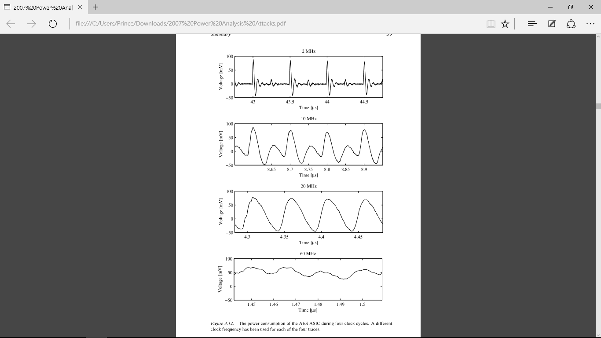
Noise
Power Supply, Clock Generator
Conducted and Radiated Emissions
Quantization Noise
Switching Noise
S. Mangard, E. Oswald, and T. Popp, Power Analysis Attacks: Revealing the Secrets of Smart Cards. New York, NY, USA: Springer, 2006
Caused by cells that are not relevant

Slide 27
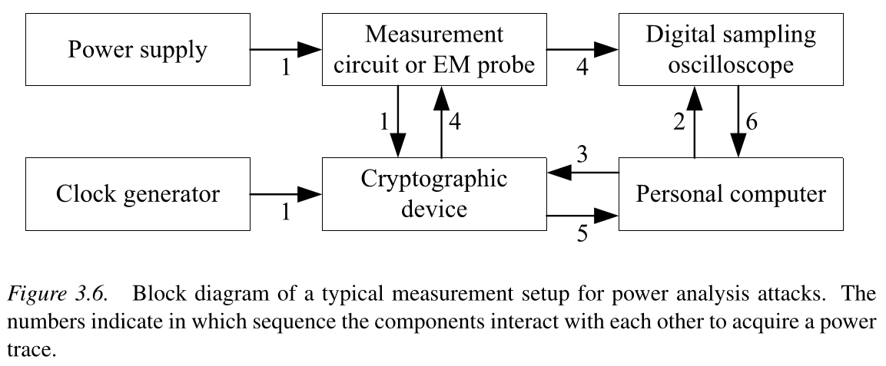
Measurement Setups
S. Mangard, E. Oswald, and T. Popp, Power Analysis Attacks: Revealing the Secrets of Smart Cards. New York, NY, USA: Springer, 2006

Slide 28
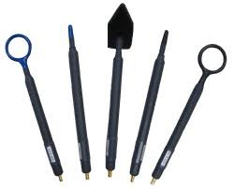
Electromagnetic Measurement
By power measurement circuits → the simplest way is to insert a small resistor between the power supply and GND
By EM probes
IEC standard 61967
→ define how conducted emissions and radiated emissions should be measured in order to test the EMC of an IC

Slide 29
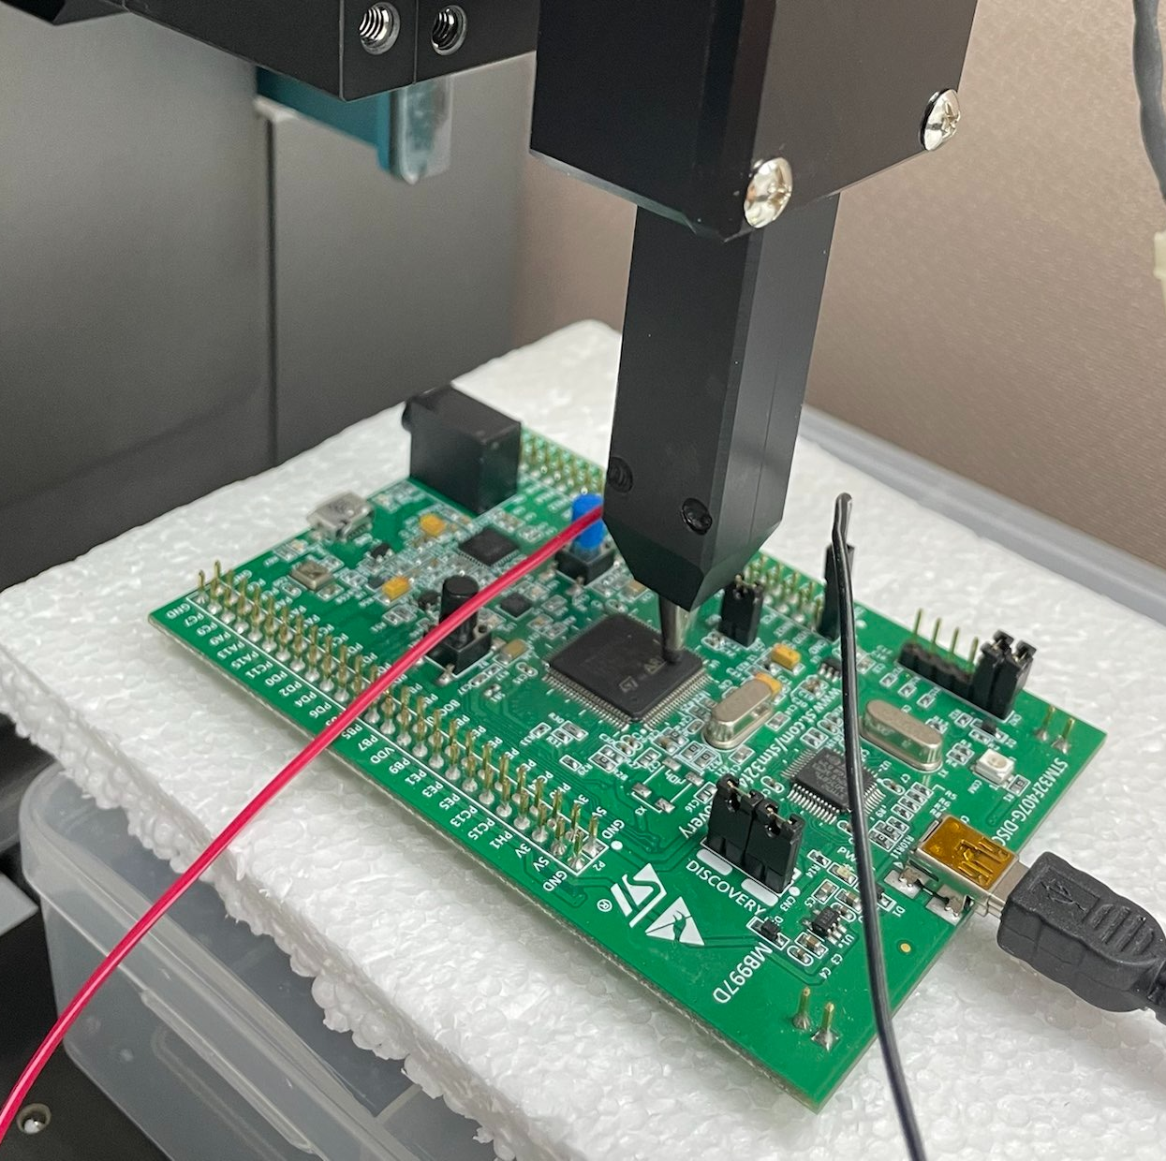

Slide 30
4. Research Papers

Slide 31
Cloning 3G/4G SIM Cards (Black Hat USA 2015) Hardware Wallets (Ledger, TREZOR… 2015-2019)
https://www.youtube.com/watch?v=qKCQ1KL9GEc
https://www.blackhat.com/docs/us-15/materials/us-15-Yu-Cloning-3G-4G-SIM-Cards-With-A-PC-And-An-Oscilloscope-Lessons-Learned-In-Physical-Security-wp.pdf
Jochen Hoenicke. Extracting the Private Key from a TREZOR. 2015. URL: https://jochen-hoenicke.de/trezor-power-analysis/.
M. Arapinis, A. Gkaniatsou, and A. Kiayias, “Low-Level Attacks in Bitcoin Wallets“ International Conf. on Info. Security (ISC), 2017.
Wouter de Boer, “Power Analysis of the Ledger Nano S” Bachelor thesis, Computer Science, Radboud University, 2018.
Ledger Donjon https://www.sstic.org/2019/presentation/side_channel_assessment_hardware_wallets/

Slide 32
Screaming channels: When electromagnetic side channels meet radio transceivers. (ACM, CCS, 2018)
Digital + Analog/RF Circuits (Mixed-Signal): on the same silicon die.
Digital Noise → Substrate Coupling → Radio Transmission
nRF51822 Bluetooth LE 2.4GHz
G. Camurati, S. Poeplau, M. Muench, T. Hayes, and A. Francillon. Screaming channels: When electromagnetic side channel smeet radio transceivers. ACM Conferenceon Computer and Communications Security, CCS, 2018.

Slide 33
Screaming channels: From a Detailed Analysis to Improved Attacks (IACR, TCHES, vol. 2020-3) Far Field EM Side-Channel Attack on AES Using Deep Learning (ACM, ASHES, 2020)
G. Camurati, A. Francillon, F.-X. Standaert, "Understanding Screaming Channels: From a Detailed Analysis to Improved Attacks." IACR TCHES 2020 vol. 3
R. Wang, H. Wang, and E. Dubrova, "Far Field EM Side-Channel Attack on AES Using Deep Learning" ACM Workshop on Attacks and Solutions in Hardware Security (ASHES), 2020.

Slide 34
A Side Journey to Titan Side Channel Attack on Google Titan Security Key (2021)
Secret Key of the Google Titan Security Key (US version) can be cloned by attackers (under some attack scenario)
Runs the FIDO U2F (Universal Second Factor) Protocol
https://ninjalab.io/a-side-journey-to-titan/
https://store.google.com/ca/product/titan_security_key?hl=en-GB
Notes:
這篇論文是 2021 年法國 Ninja 實驗室發表的成果，是 Usenix Security 的論文。
結論就是 Google Titan 這顆晶片的 Security Key 可以被攻擊者完全攻擊出來。
由於 Google Titan Security chip 是來自於 NXP 的某個類型晶片，所以其實 NXP 的很多系列晶片，也一併受到影響。

Slide 35
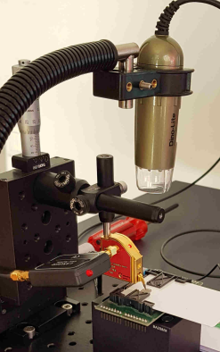
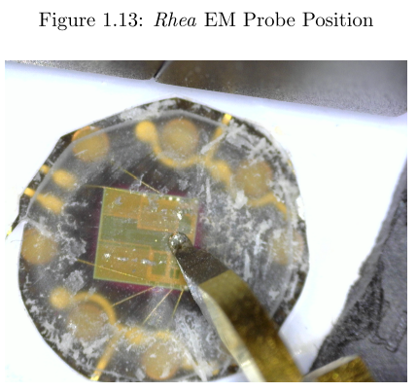
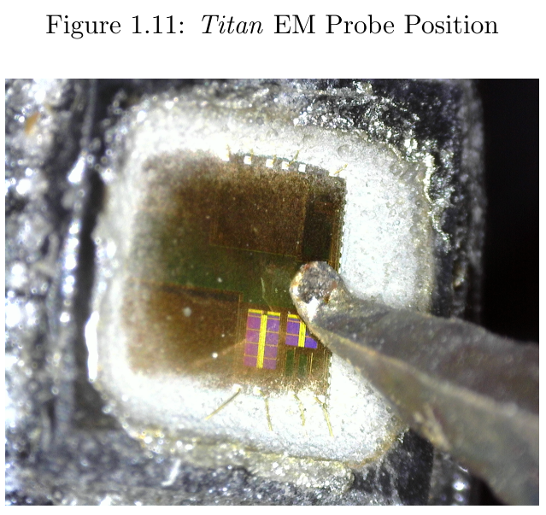
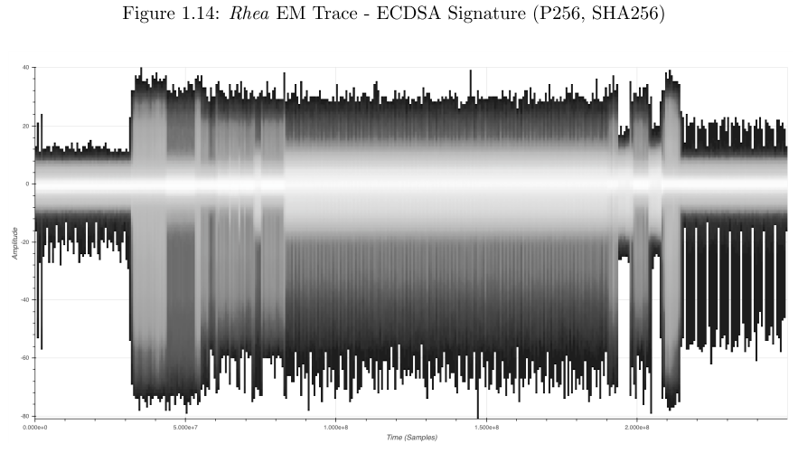
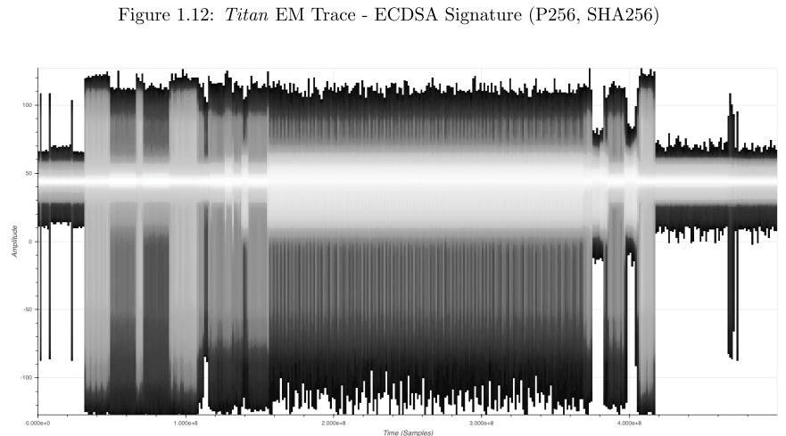
https://ninjalab.io/a-side-journey-to-titan/
Notes:
因為 Google 當然不會告訴你用什麼晶片，所以找一個類似的晶片，例如 NXP A700x 這顆的 Family，在這篇論文取名 Rhea (土星的第二大衛星)， 在架設 Rhea 這顆晶片的環境後，我們可以在上面執行數位簽章等運算。
然後再它運行的時候去做旁通道量測，再藉由量測結果去比對 Google Titan 的結果，這樣才可以知道量測到裡洩漏了什麼資訊。 Rhea 是跑 JavaCard 的作業系統，所以在這上面可以看到的是 JavaCard (在 applet, 上執行 ECDSA 簽章)

Slide 36
A Side Journey to Titan Side Channel Attack on Google Titan Security Key (2021)
Other possibly impacted products
Several NXP JavaCard smartcards based on P5x chips
Google Titan Security Key (EU version)
Yubico Yubikey Neo
Feitian FIDO NFC USB-A / K9, MultiPass FIDO / K13,
Feitian ePass FIDO USB-C/ K21, FIDO NFC USB-C/ K40
https://ninjalab.io/a-side-journey-to-titan/
https://store.google.com/ca/product/titan_security_key?hl=en-GB

Slide 37
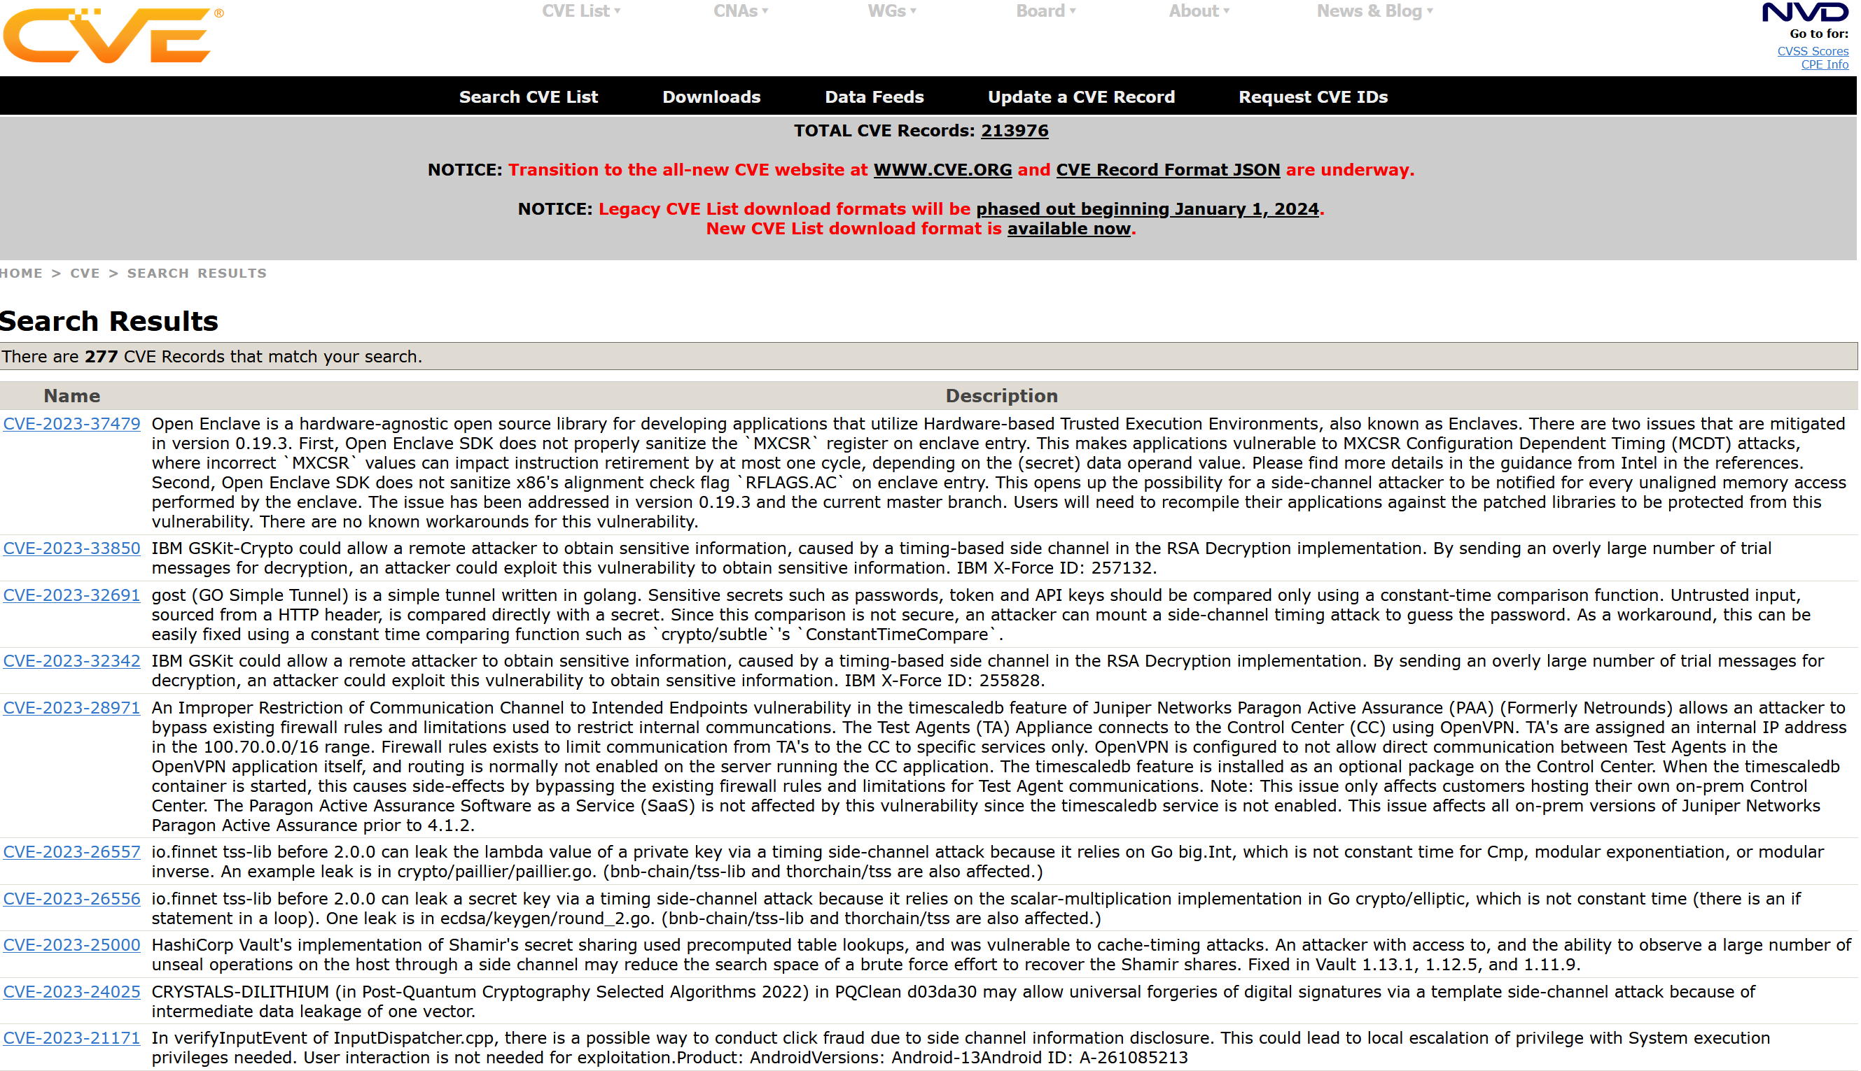
CVE, Common Vulnerabilities and Exposures

Slide 38
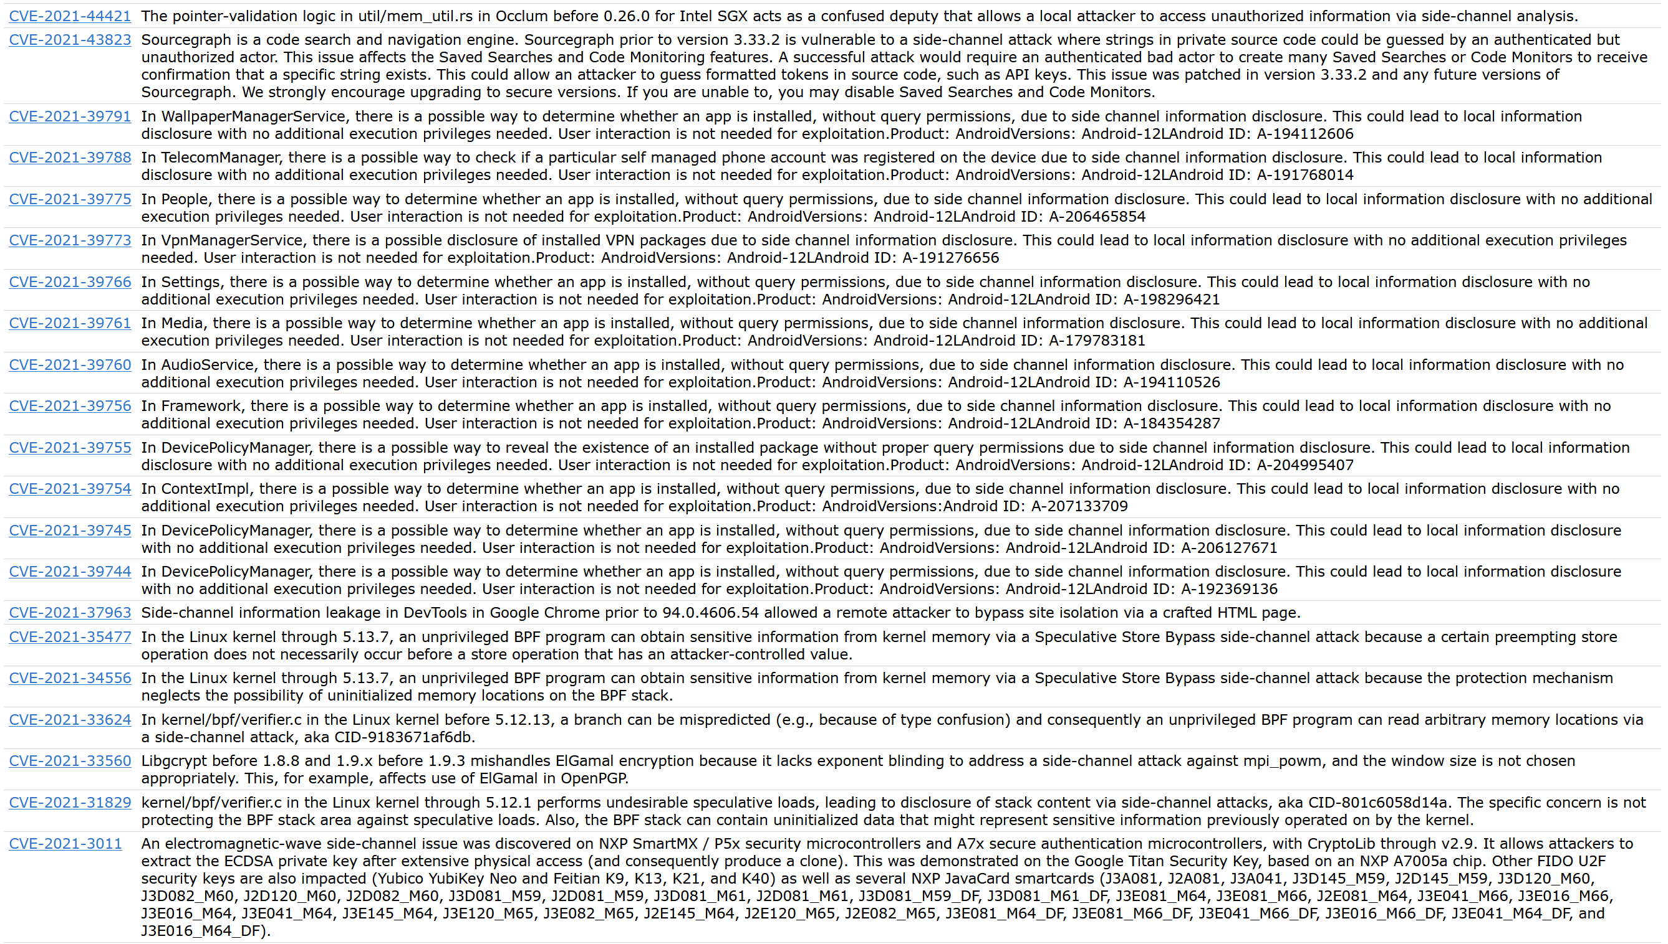
CVE, Common Vulnerabilities and Exposures

Slide 39
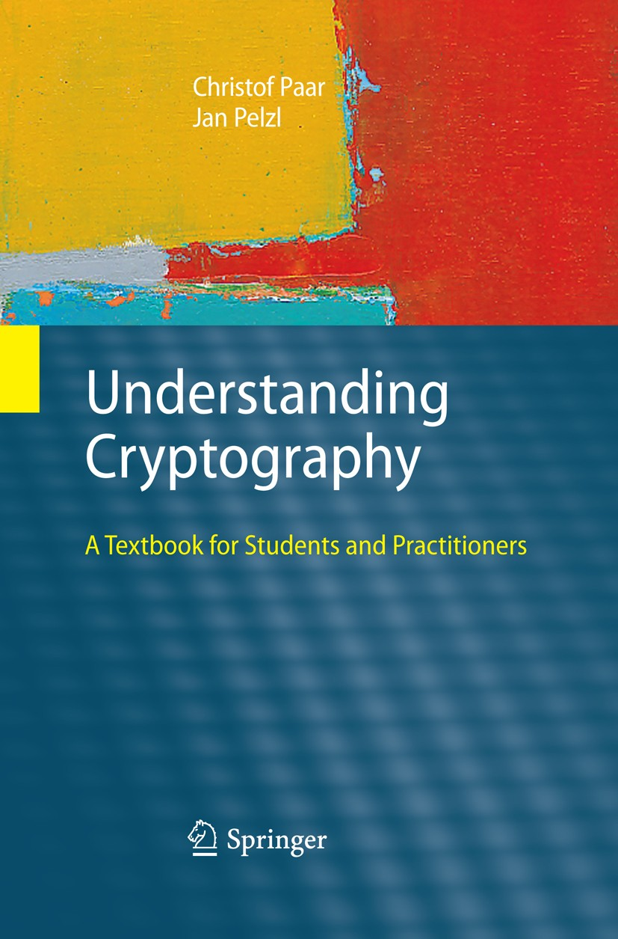


5. Advanced Encryption Standard
Understanding cryptography (Ch.4)
Christof Paar
Jan Pelzl
Max Planck Institute for Security and Privacy
University of Applied Sciences, Hamm-Lippstadt
https://link.springer.com/book/10.1007/978-3-642-04101-3
https://www.mpi-sp.org/39026/christof-paar
https://www.hshl.de/personen/prof-dr-ing-jan-pelzl

Slide 40
AES
Overview of the AES algorithm
Internal structure of AES
Byte Substitution layer
Diffusion layer
Key Addition layer
Key schedule
Decryption
Practical issues

Slide 41
Overview of the AES algorithm
AES is the most widely used symmetric cipher today
The algorithm for AES was chosen by the US National Institute of Standards and Technology (NIST) in a multi-year selection process
The requirements for all AES candidate submissions were:
Block cipher with 128-bit block size
Three supported key lengths: 128, 192, and 256 bits
Security relative to other submitted algorithms
Efficiency in software and hardware

Slide 42
Chronology of the AES Selection
The need for a new block cipher was announced by NIST in January 1997
15 candidates algorithms were accepted in August 1998 and 5 finalists were announced in August 1999:
Rijndael – J. Daemen & V. Rijmen
Serpent – Eli Biham et al.
Twofish – B. Schneier et al.
RC6 – RSA Laboratories
Mars – IBM Corporation
In October 2000, Rijndael was chosen as the AES. And AES was formally approved as a US federal standard in November 2001

Slide 43
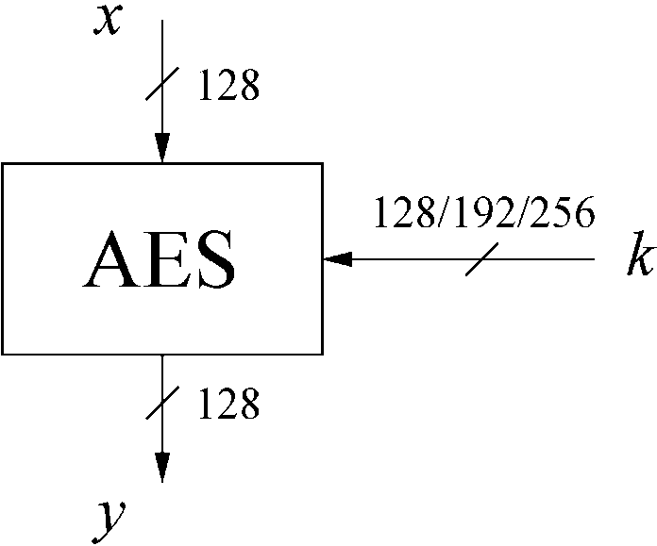
AES: Overview
The number of rounds depends on the chosen key length:
Key length (bits) | Number of rounds
128 | 10
192 | 12
256 | 14

Slide 44
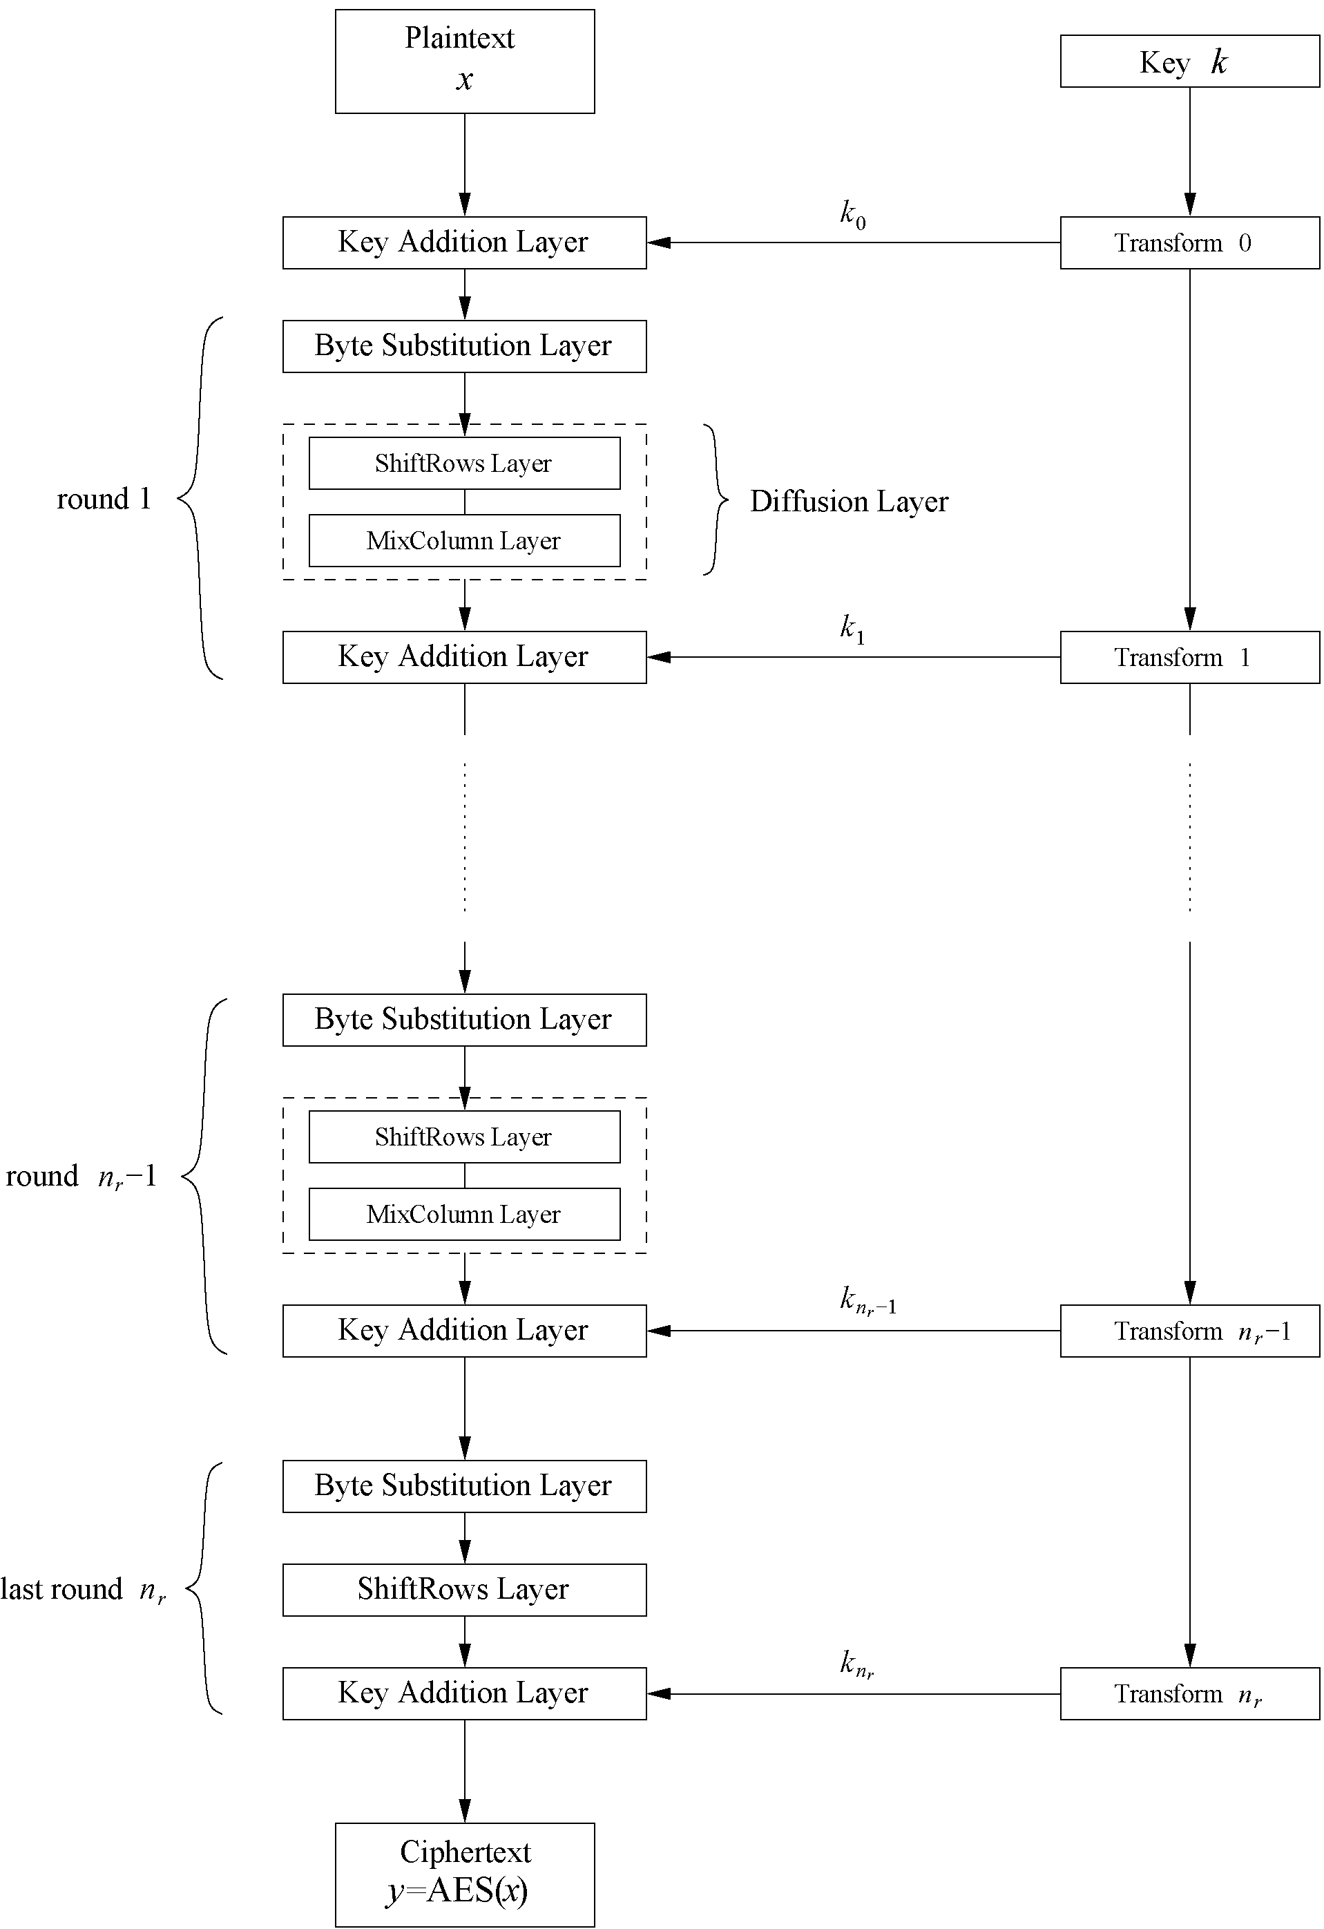
AES: Overview
Iterated cipher with 10/12/14 rounds
Each round consists of “Layers”

Slide 45
AES: Overview
https://www.youtube.com/watch?v=mlzxpkdXP58

Slide 46
Internal structure of AES
AES is a byte-oriented cipher
The state A (i.e., the 128-bit data path) can be arranged in a 4 × 4 matrix:
with A₀, …, A₁₅ denoting the 16-byte input of AES
A₀ | A₄ | A₈ | A₁₂
A₁ | A₅ | A₉ | A₁₃
A₂ | A₆ | A₁₀ | A₁₄
A₃ | A₇ | A₁₁ | A₁₅

Slide 47
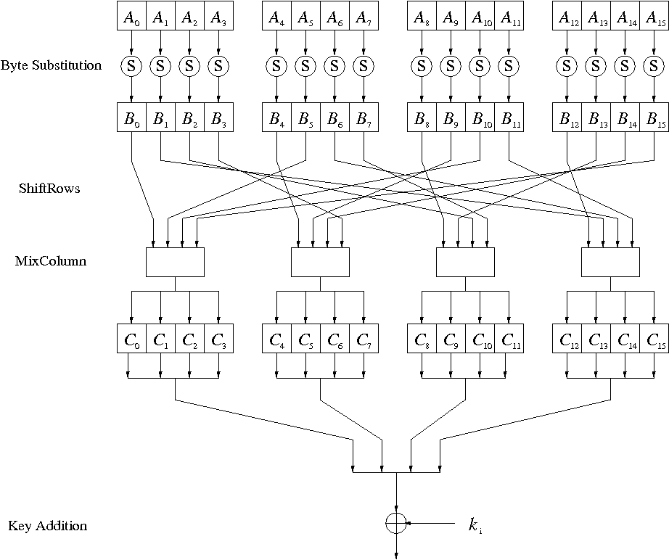
Internal Structure of AES
Round function for rounds 1, 2, …, n_{r –1}:
Note: In the last round, the MixColumn tansformation is omitted

Slide 48
Byte Substitution Layer
This layer consists of 16 S-Boxes with the following properties:
Identical, The only nonlinear operation of AES,
i.e., ByteSub(A_{i}) + ByteSub(A_{j}) ≠ ByteSub(A_{i} + A_{j}), for i, j = 0, …, 15
Bijective, i.e., there exists a one-to-one mapping of input and output bytes ⇒ S-Box can be uniquely reversed
In software implementations, the S-Box is usually realized as a lookup table

Slide 49
Diffusion Layer
The Diffusion layer
provides diffusion over all input state bits
consists of two sublayers:
ShiftRows Sublayer: Permutation of the data on a byte level
MixColumn Sublayer: Matrix operation which combines (“mixes”) blocks of four bytes
performs a linear operation on state matrices A, B, i.e.,
DIFF(A) + DIFF(B) = DIFF(A + B)

Slide 50
ShiftRows Sublayer
Rows of the state matrix are shifted cyclically:
Input matrix:
Output matrix:
B₀ | B₄ | B₈ | B₁₂
B₁ | B₅ | B₉ | B₁₃
B₂ | B₆ | B₁₀ | B₁₄
B₃ | B₇ | B₁₁ | B₁₅
B₀ | B₄ | B₈ | B₁₂
B₅ | B₉ | B₁₃ | B₁
B₁₀ | B₁₄ | B₂ | B₆
B₁₅ | B₃ | B₇ | B₁₁
no shift
← one position left shift
← two positions left shift
← three positions left shift

Slide 51
MixColumn Sublayer
Linear transformation which mixes each column of the state matrix
Each 4-byte column is considered as a vector and multiplied by a fixed 4 × 4 matrix, e.g.,
where 01, 02 and 03 are given in hexadecimal notation
All arithmetic is done in the Galois field GF(2⁸)

Slide 52
Key Addition Layer
Inputs:
16-byte state matrix C
16-byte subkey k_{i}
Output: C ⊕ k_{i}
The subkeys are generated in the key schedule

Slide 53
Key Schedule
Subkeys are derived recursively from the original 128/192/256-bit input key
Each round has 1 subkey, plus 1 subkey at the beginning of AES
Key whitening: Subkey is used both at the input and output of AES ⇒ # subkeys = # rounds + 1
There are different key schedules for the different key sizes
Key length (bits) | Number of subkeys
128 | 11
192 | 13
256 | 15

Slide 54
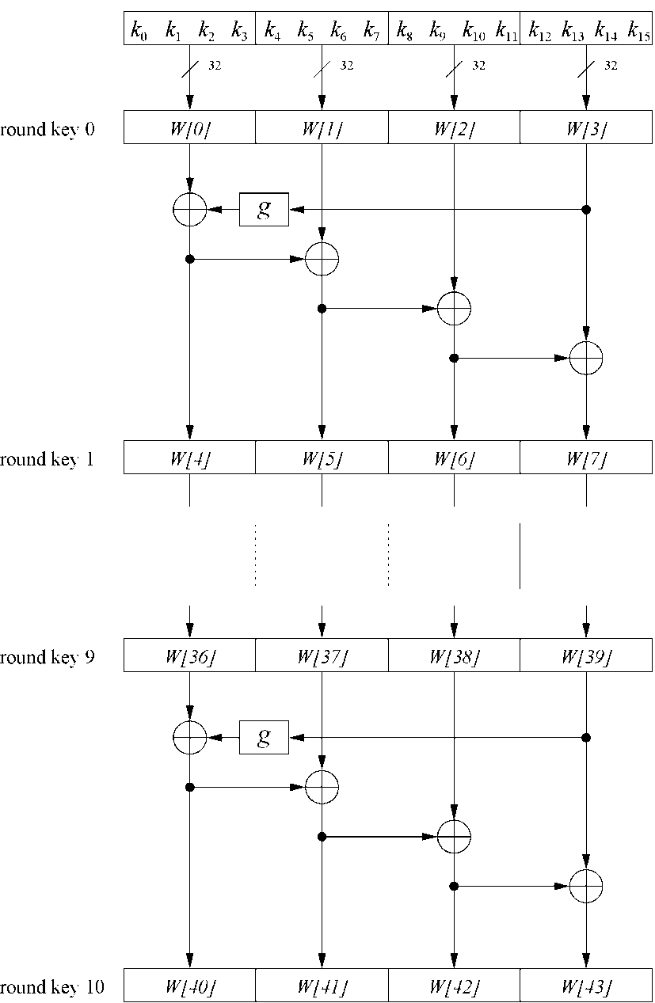
Key Schedule
Example: Key schedule for 128-bit key AES
Word-oriented: 1 word = 32 bits
11 subkeys are stored in W [0], … , W [3], W [4], … , W [7], … , W [40], … , W [43]
First subkey W [0]…W [3] is the original AES key

Slide 55
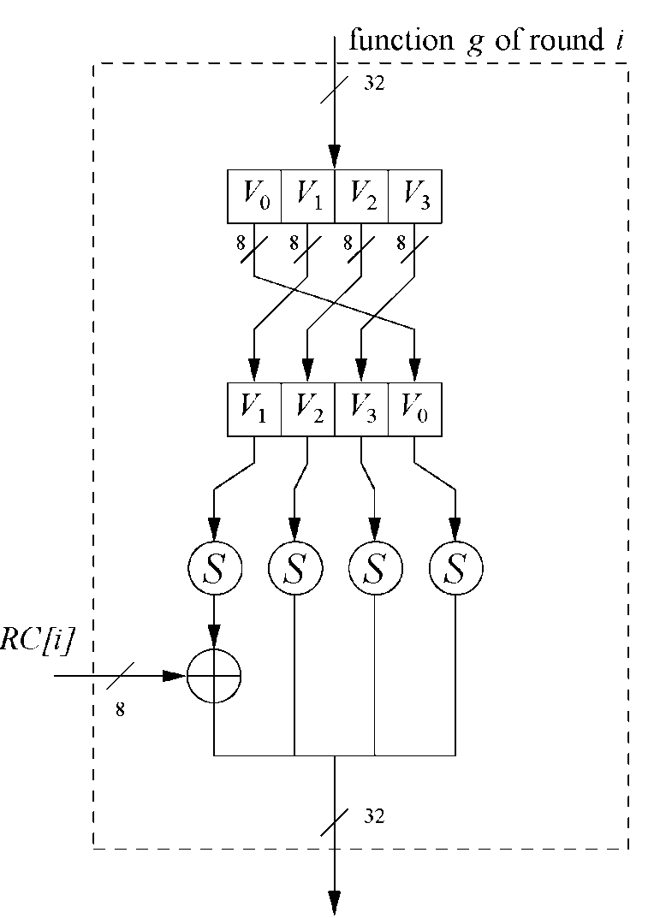
Key Schedule
Function g rotates its four input bytes and performs a bytewise S-Box substitution ⇒ nonlinearity
The round coefficient RC is only added to the leftmost byte and varies from round to round: RC[1] = x⁰ = (00000001)₂
RC[2] = x¹ = (00000010)₂
RC[3] = x² = (00000100)₂ ...
RC[10] = x⁹ = (00110110)₂
x ^{i} represents an element in a Galois field

Slide 56
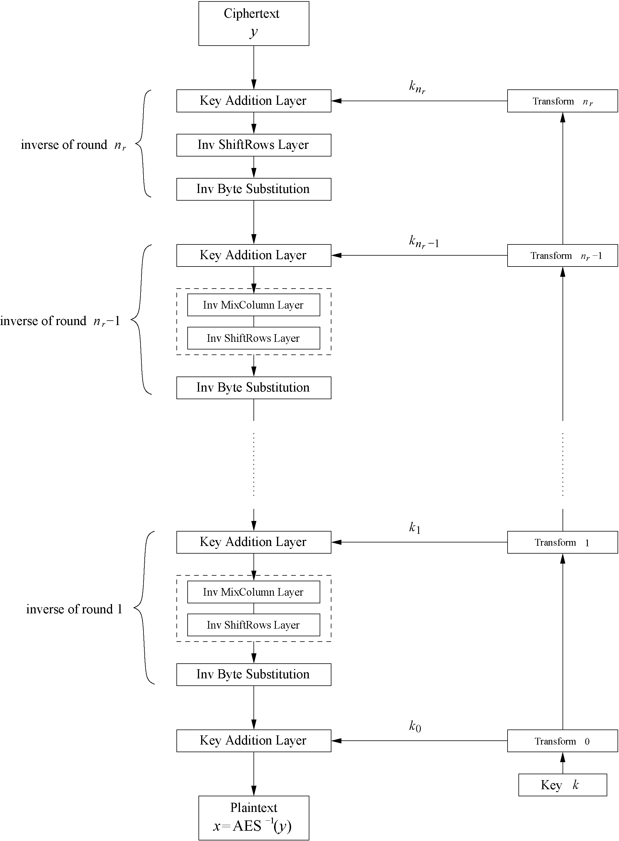
Decryption
AES is not based on a Feistel network ⇒ All layers must be inverted for decryption:
MixColumn layer →
Inv MixColumn layer
ShiftRows layer →
Inv ShiftRows layer
Byte Substitution layer →
Inv Byte Substitution layer
Key Addition layer is its own inverse

Slide 57
Decryption
Inv MixColumn layer:
To reverse the MixColumn operation, each column of the state matrix C must be multiplied with the inverse of the 4 × 4 matrix, e.g.,
where 09, 0B, 0D and 0E are given in hexadecimal notation
Again, all arithmetic is done in the Galois field GF(2⁸)

Slide 58
Decryption
Inv ShiftRows layer:
All rows of the state matrix B are shifted to the opposite direction:
Input matrix:
Output matrix:
B₀ | B₄ | B₈ | B₁₂
B₁ | B₅ | B₉ | B₁₃
B₂ | B₆ | B₁₀ | B₁₄
B₃ | B₇ | B₁₁ | B₁₅
B₀ | B₄ | B₈ | B₁₂
B₁₃ | B₁ | B₅ | B₉
B₁₀ | B₁₄ | B₂ | B₆
B₇ | B₁₁ | B₁₅ | B₃
no shift
→ one position right shift
→ two positions right shift
→ three positions right shift

Slide 59
Decryption
Inv Byte Substitution layer:
Since the S-Box is bijective, it is possible to construct an inverse, such that A_{i} = S ^{–1}(B_{i}) = S ^{–1}(S(A_{i}))
⇒ The inverse S-Box is used for decryption. It is usually realized as a lookup table.
Decryption key schedule:
Subkeys are needed in reversed order (compared to encryption)
In practice, the same key schedule is used for encryption and decryption. This requires that all subkeys must be computed before the encryption of the first block can begin

Slide 60
Implementation in Software
One requirement of AES was the possibility of an efficient software implementation
Straightforward implementation is well suited for 8-bit processors (e.g., smart cards), but inefficient on 32-bit or 64-bit processors

Slide 61
Implementation in Software
A more sophisticated approach: Merge all round functions (except the key addition) into one table look-up
This results in four tables with 256 entries, where each entry is 32 bits wide
One round can be computed with 16 table look-ups
Typical SW speeds are more than 1.6 Gbit/s on modern 64-bit processors

Slide 62
Security
Brute-force attack: Due to the key length of 128, 192 or 256 bits, a brute-force attack is not possible
Analytical attacks: There is no analytical attack known that is better than brute-force
Side-channel attacks:
Several side-channel attacks have been published
Note that side-channel attacks do not attack the underlying algorithm but the implementation of it

Slide 63
Lessons Learned
AES is a modern block cipher that supports three key lengths of 128, 192, and 256 bits. It provides excellent long-term security against brute-force attacks.
AES has been studied intensively since the late 1990s, and no attacks have been found that are better than brute-force.
AES’s basic operations use Galois field arithmetic and provide strong diffusion and confusion.

Slide 64
Lessons Learned
AES is part of numerous open standards, such as IPsec or TLS, and is the mandatory encryption algorithm for US government applications.
It seems likely that the cipher will be the dominant encryption algorithm for many years.
AES is efficient in software and hardware.

Slide 65
6. Power Analysis
Side-Channel Analyses (Attacks)
SPA (Simple Power Analysis)
DPA (Differential Power Analysis)
DoM (Difference of Means)
CPA (Correlation Power Analysis)
MIA (Mutual Information Analysis)
LR-Based Attacks (Linear Regression)
….

Slide 66
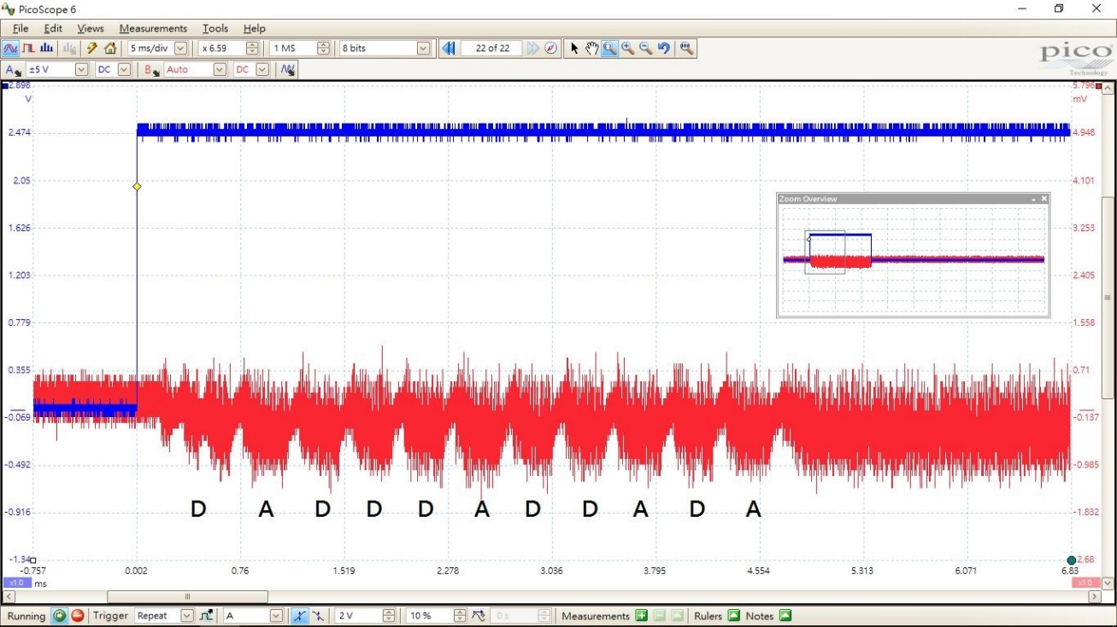
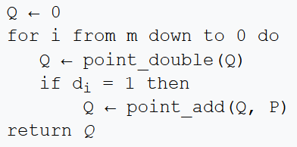
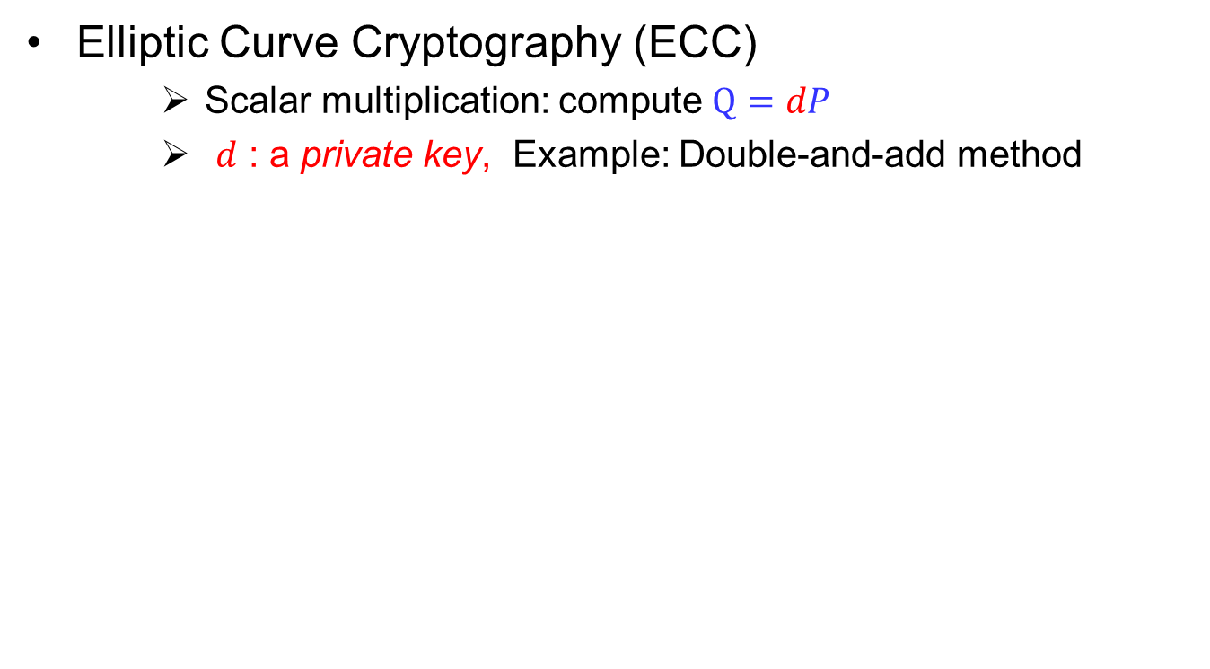
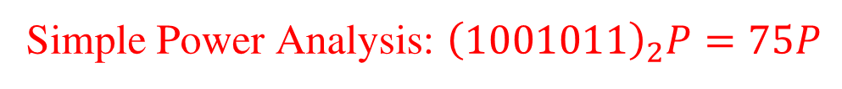
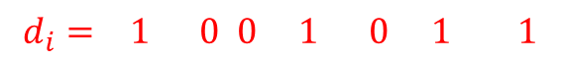
Simple Power Analysis
Elliptic Curve Cryptography (ECC)
Scalar multiplication: compute $Q=dP$
$d$ : a private key, Example: Double-and-add method
$$d_{i}= 1 0 0 1 0 1 1$$
Simple Power Analysis: ${\left(1001011\right)}_{2}P=75P$
https://en.wikipedia.org/wiki/Elliptic_curve_point_multiplication
Notes:
橢圓曲線密碼學，基於離散對數問題，Q=dP, 知道 P, Ｑ很難求 d；一般選擇完適合的曲線後，Base point P 也同時決定。
基於 P 再生成公鑰 Q 的時候，最簡單的方式，是 Double-and-add method。
也就是將私鑰 d 用二進位展開，遇到 0 的時候，做一個 Double, 遇到 1 的時候呢，做一個 Double 再做一個 Add.
運算的過程中，如果 Double 與 Add 的功率消耗曲線不同，如圖所示，就很有可能被解出私鑰的數值。
例如 Double-and-add method 運算時，將中間的功率消耗記錄下來，變成這樣的曲線。
然後我門找尋裡面的波形特徵， Double 長什麼樣，Add 長什麼樣，然後整個列出來之後，寫出對應的數字，一個 double, 一個 add 對應到一個 1, 單純只有一個 double 對應到一個 0；因此展開成二進制 ${\left(1001011\right)}_{2}$ 之後，我們知道是 d = 75。

Slide 67
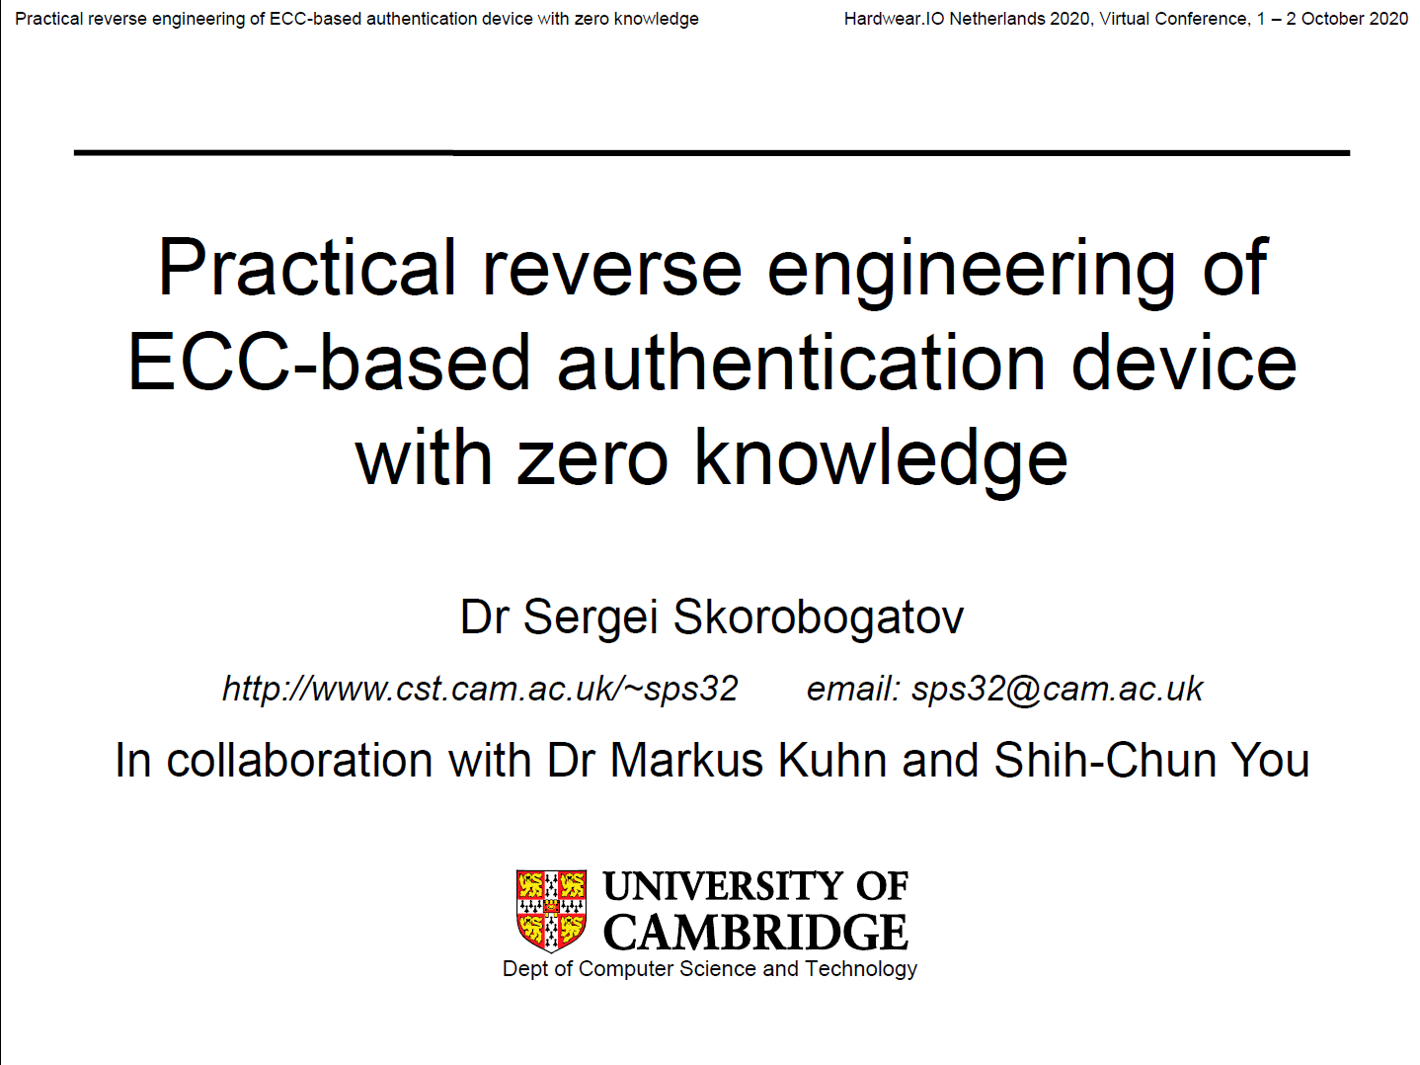
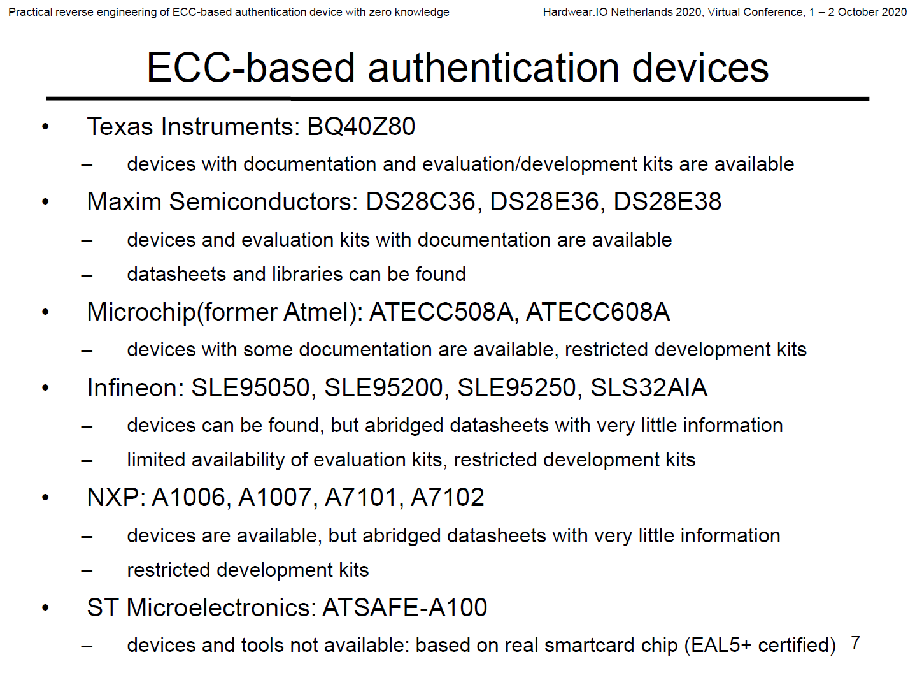
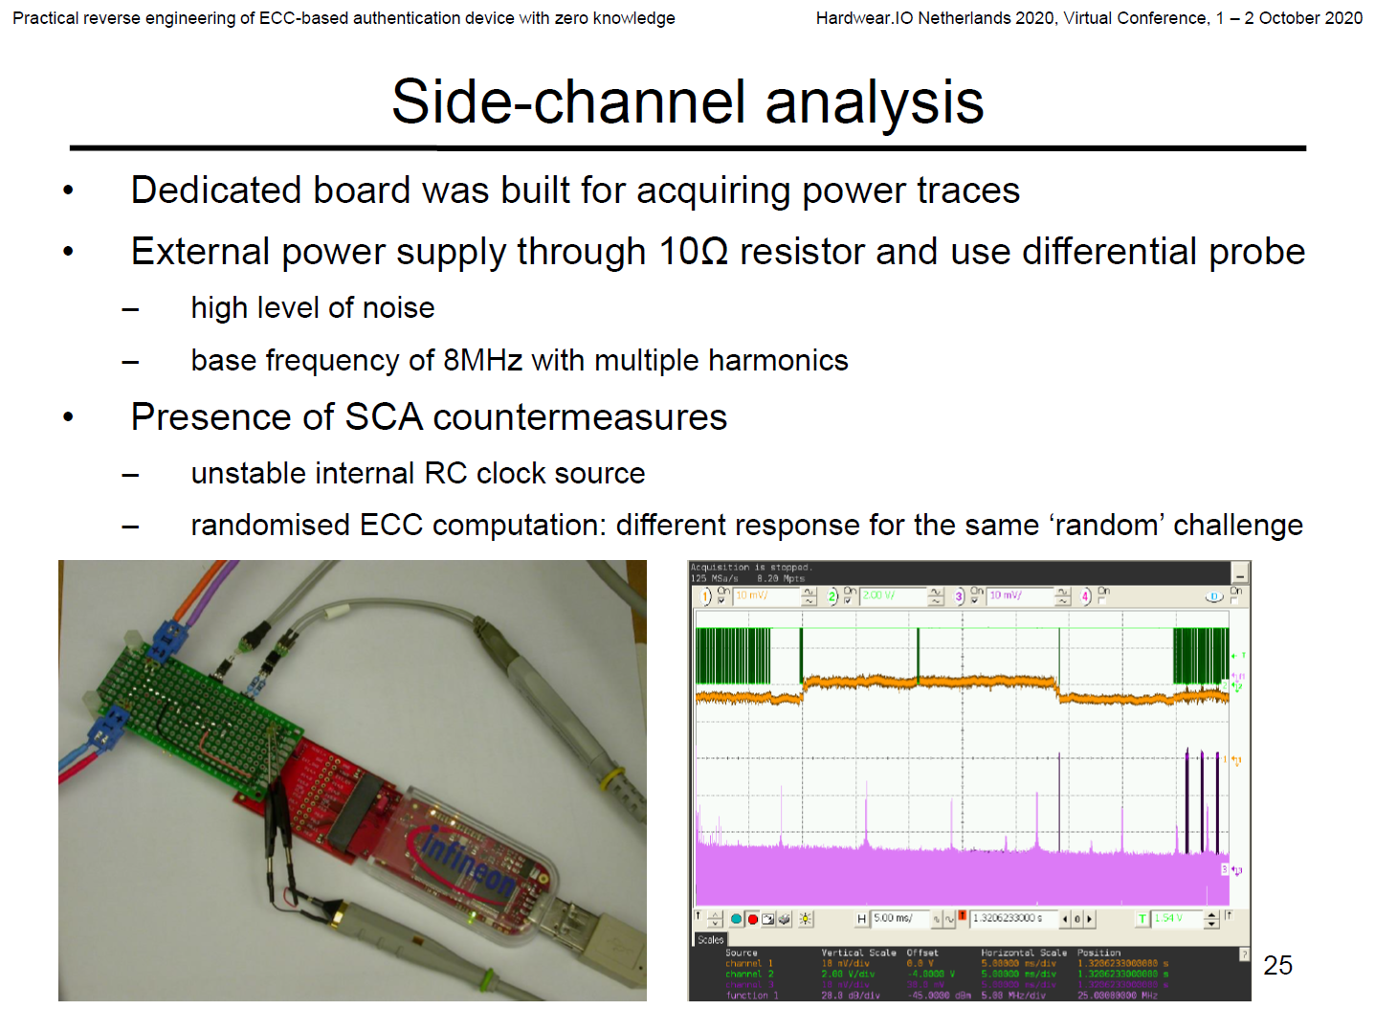
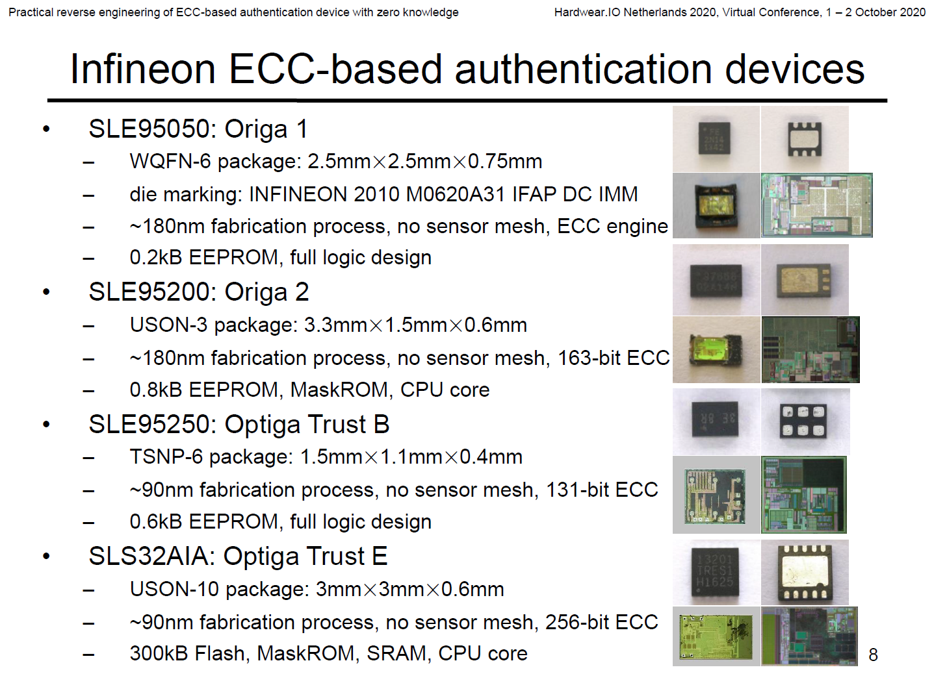
Advised: Feb. 2015 – Oct. 2018
https://www.cl.cam.ac.uk/~sps32/

Slide 68
How DPA Works?
Fortunately, the 16 bytes are independent of each other before MixColumn in the first rounds.
Fisrt round key
SubByte
MixColumn
Divid and Conquer!
X128 to 16x 28

Slide 69
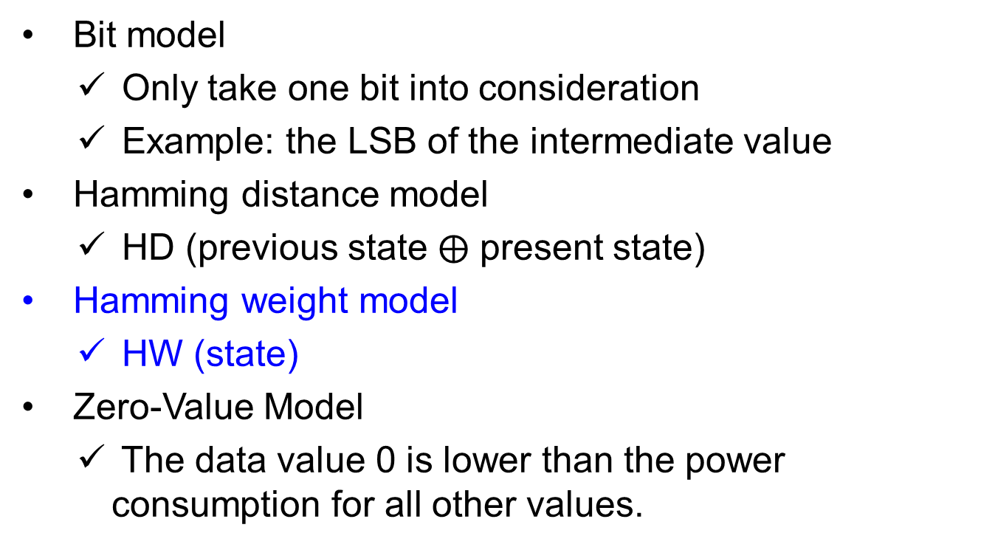
Some Popular Models
Bit model
Only take one bit into consideration
Example: the LSB of the intermediate value
Hamming distance model
HD (previous state $⨁$ present state)
Hamming weight model
HW (state)
Zero-Value Model
The data value 0 is lower than the power consumption for all other values.

Slide 70
Power Analysis Models
Take hypothetical intermediate values as input, and output hypothetical power consumptions.
Power model: Power = a ‧ # bitflips + n
a : power consumption from components
n : normal distribution noise
Hamming Weight: HW (10100100) = 3
Hamming Distance: HD (00110101, 00100111) = 2
S. Mangard, E. Oswald, and T. Popp, Power Analysis Attacks: Revealing the Secrets of Smart Cards. New York, NY, USA: Springer, 2006, Ch. 3.
François-Xavier Standaert, Introduction to Side-Channel Attacks, Secure Integrated Circuits and Systems, NY, USA: Springer , 2010, pp. 27-42.

Slide 71
Differential Power Analysis
Compared to SPA, DPA
Do not need detailed knowledge about the devices
Usually need a large amount of traces that operate on different data
Need to process the devices
Three disciplines
Cryptanalysis: Target a good intermediate value
Engineering: Get Side-Channel leakage precisely
Statistics: Verify key hypothesis

Slide 72
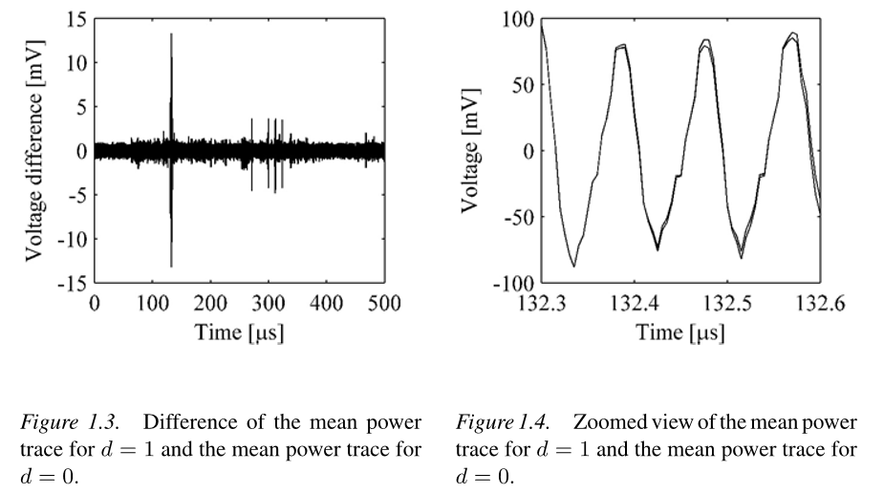
Differential Power Analysis
S. Mangard, E. Oswald, and T. Popp, Power Analysis Attacks: Revealing the Secrets of Smart Cards. New York, NY, USA: Springer, 2006

Slide 73
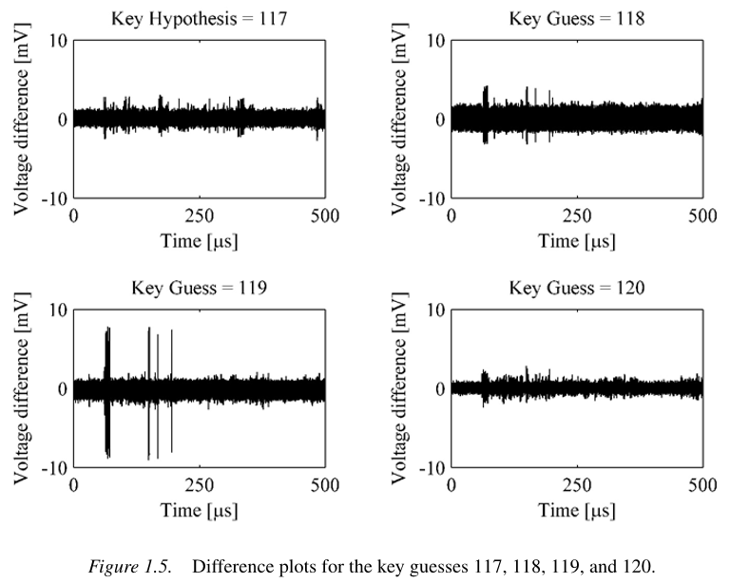
Differential Power Analysis
S. Mangard, E. Oswald, and T. Popp, Power Analysis Attacks: Revealing the Secrets of Smart Cards. New York, NY, USA: Springer, 2006

Slide 74
Choosing an Intermediate Value
A good intermediate value
Depends on part of key and plaintext /ciphertext: f(p,k) or f(c,k’)
A non-linear f is better: such as the output of Sbox
Examples:
Sbox (p⊕k)
Sbox⁻¹(ShiftRow(c⊕k’))
Calculate hypothetical intermediate values for every possible key candidates

Slide 75
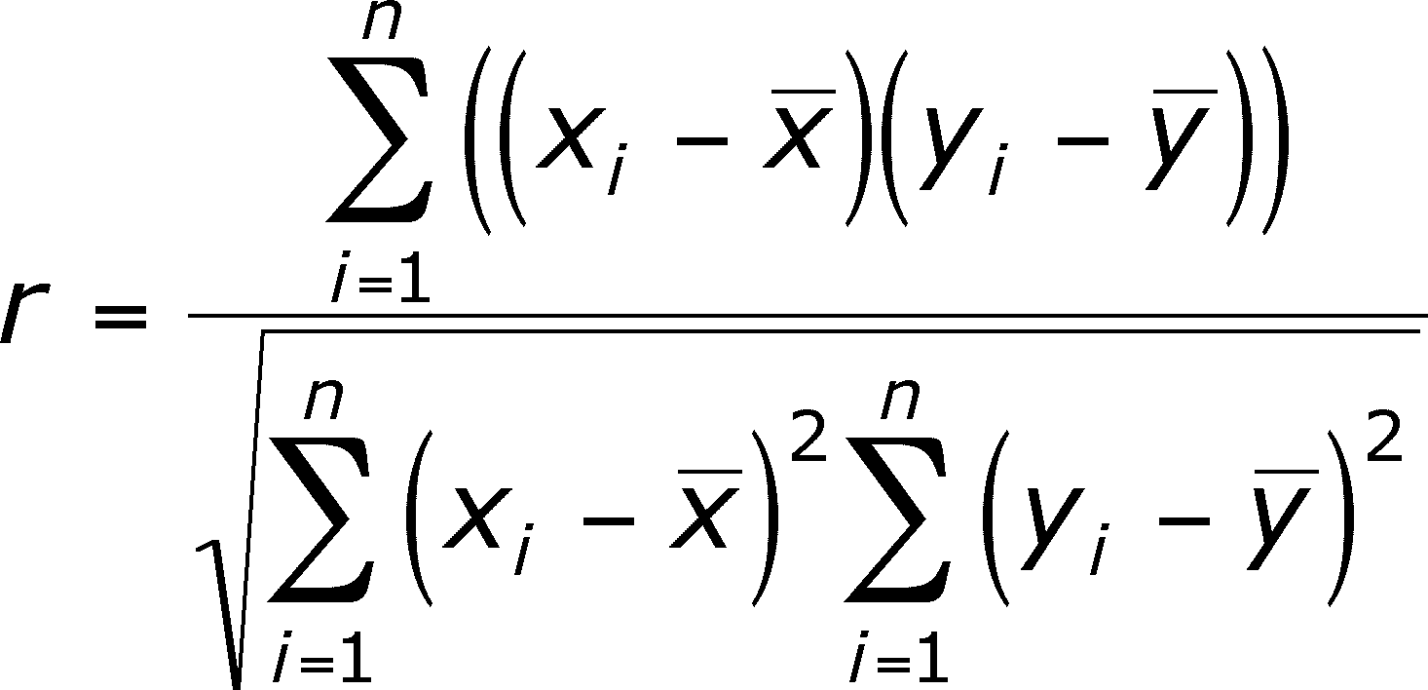
Correlation Coefficients
Assumption: the linearity between power consumption and #bitflips
Pearson’s correlation coefficient detects the linear dependencies of two variables

Slide 76
Correlation Power Analysis, CPA
Use correlation coefficient as statistical test
Proposed at 2004
Eric Brier, Christophe Clavier, Francis Olivier. Correlation Power Analysis with a Leakage Model. CHES 2004: pp.16-29
2023/10/12 Times Cited: 3127
One of the most popular DPA attacks, usually used as a baseline DPA

Slide 77
CPA Workflow
Choosing an intermediate value
Measuring the power consumptions
Calculating hypothetical intermediate values
Mapping intermediate values to hypothetical power consumption (Power model)
Comparing the hypothetical consumption with real power consumption (Statistics test)

Slide 78
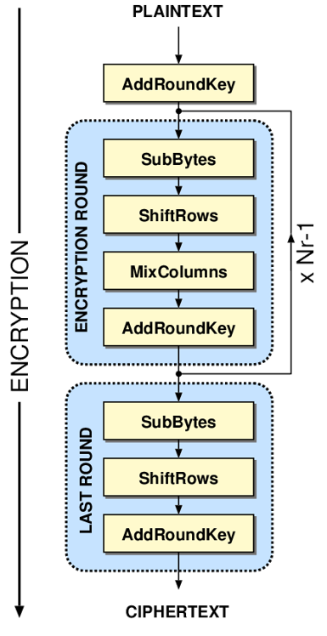
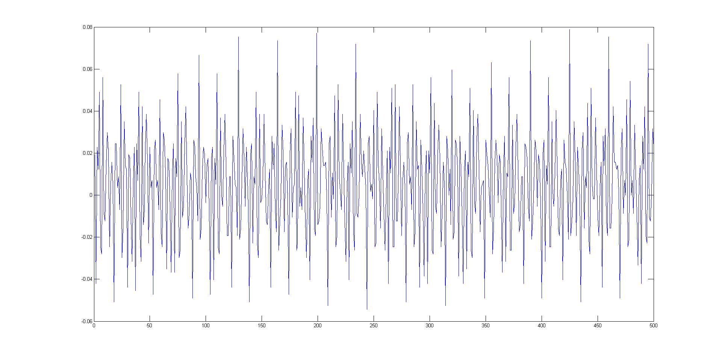
Analytics Workflow
Targeted intermediate value
Step 1: Choose the target intermediate value
Example: on AES-128
The 16 bytes are independent before MixColumns in the first round
So we can process it byte by byte
Divide and Conquer!!
Step 2: Measure the power traces
1 (D=1) x T (points)
https://en.wikipedia.org/wiki/Advanced_Encryption_Standard
Mangard, E. Oswald, and T. Popp, Power Analysis Attacks: Revealing the Secrets of Smart Cards. New York, NY, USA: Springer, 2006

Slide 79
Analytics Workflow
Step 2: Measure the power traces (record data)
1 (D=1) x T (points)
Plaintexts
Traces
0x3128A6DA……7C
0.021
0.734
-0.388
…
0xA24B6E1D……97
0.053
0.681
-0.172
…
…
…
0x6C7B32C…...…82
-0.105
0.592
…
0.073
D records
D x 16(Byte)
D x T(points)
D recodes and Sampling T
S. Mangard, E. Oswald, and T. Popp, Power Analysis Attacks: Revealing the Secrets of Smart Cards. New York, NY, USA: Springer, 2006
Notes:
在明文：D 筆記錄，每條記錄丟 128 bits (16Byte) 進去，對應到 D 比記錄，每筆記錄有 T 個量測點

Slide 80
Analytics Workflow
Plaintexts (first byte)
Calculate hypothetical intermediate value
Sbox (p ⊕ k)
0x31
Key hypothesis (256 kinds)
0x00
0x01
…
0xFF
0xA2
1 x K, (K=256)
…
0xC7
0x04
0x8B
…
0x6C
0x37
0x0A
0x4C
D x 1(Byte)
…
…
0x50
0x3C
…
0xDC
Step 3: Choose a power model
D x 256
Power model
HW(‧)
S. Mangard, E. Oswald, and T. Popp, Power Analysis Attacks: Revealing the Secrets of Smart Cards. New York, NY, USA: Springer, 2006
Notes:
將每 D 筆記錄 的第一個 Byte, 分別與一個 Byte 的 256 種可能，經過 S-Box 的中間值運算，得到一個 D x 256 的大矩陣。 挑選適合的 Model。以這個例子來說， D x 256 這個大矩陣的左下角，是16 進位的 0x50。

Slide 81
Analytics Workflow
Step 4: Calculate the hypothetical intermediate value and corresponding hypothetical power consumption
5
1
4
…
5
2
3
…
…
0x50 =10010000
2
4
…
5
Traces
D x K
0.021
0.734
-0.388
…
Statistical model
correlation(‧ , ‧)
0.053
0.681
-0.172
…
…
-0.105
0.592
…
0.073
D x T
Notes:
D x 256 大矩陣左下角是16 進位的 0x50，對應到適合的 Model 數值是 2 ，再與之前量到的 D X T 的大矩陣經過 Correlation 的運算

Slide 82
Analytics Workflow
Step 5: Apply the statistic analysis between measured power consumption and hypothetical power consumption
Key 0x00
0.005
-0.124
0.181
…
Key 0x01
0.013
0.090
-0.103
…
…
…
Key 0x13
0.053
0.372
-0.084
…
…
…
Key 0xFF
-0.131
0.095
…
-0.001
K x T
Correlation coefficients matrix
0x13 is the correct key of the first byte !
Notes:
得到一個 K x T 的矩陣。這時候我們可以看，相關性最高的是我們猜 0x00-0xFF 哪個數值，就猜這 AES 128 Key 的第一個 Byte 數值為這個。 舉例來說，這個例子是 0x13 這個結果。

Slide 83
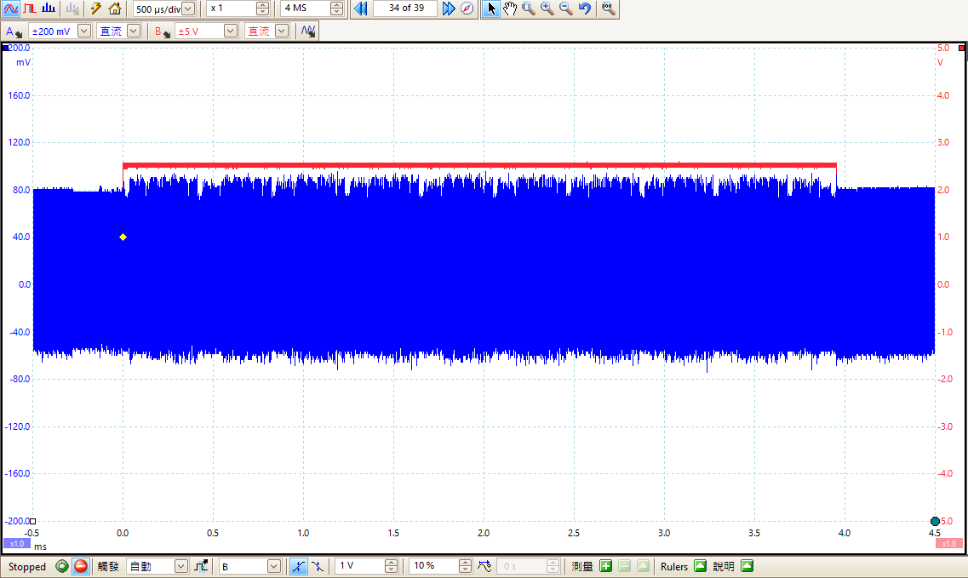
Measurement Results

Slide 84
Remarks
Why is the Hamming Weight model suitable?
In software case, the intermediate value may be moved between register and memory several times
Bus may be precharged before moving data
For hardware circuits, Hamming Distance model may be more suitable.

Slide 85
Choosing an Statistics Test
Fact: the linearity between power consumption and #bitflips (i.e. Hamming distance)
So Pearson’s correlation coefficient is a well-suited statistics test since it detects the linear dependencies of two variables
That is so-called “Correlation Power Analysis (CPA)”

Slide 86
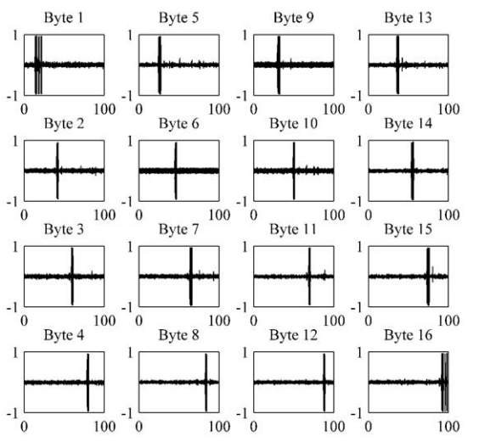
Results by Hamming weight model

Slide 87
Countermeasures
Hiding : Breaking the link between the power consumption of the devices and the processed data values.
Dual-rail, Pre-charge logic cell:
Parallel computing:
Shuffling:
a
DRP cell
a+b
a’
b
(a+b)’
b’
S₁
S₂
…
S₁₆
…
S₁₆
S₁
S₁
S₁₁
S₂
S₃
S₃
S₇
S₁₅
S₆
S. Mangard, E. Oswald, and T. Popp, Power Analysis Attacks: Revealing the Secrets of Smart Cards., NY, USA: Springer, 2006

Slide 88
Countermeasures
Masking:
Without changing the power consumption of the device.
Each intermediate value v is concealed by a random value m that is called mask: v_{m} = v * m.
(P ⊕ m)
⊕
function
Q’
P
Q
⊕
Q
m
mask process
m’
S. Mangard, E. Oswald, and T. Popp, Power Analysis Attacks: Revealing the Secrets of Smart Cards., NY, USA: Springer, 2006
Notes:
不改變原本 Device 原本的特性，而達到防護的效果。

Slide 89
Conclusion
Cryptography
Cache Attacks; Signal processing
Invasive Attack
Side Channel Analysis
Software
Hardware
Embedded System

Slide 90
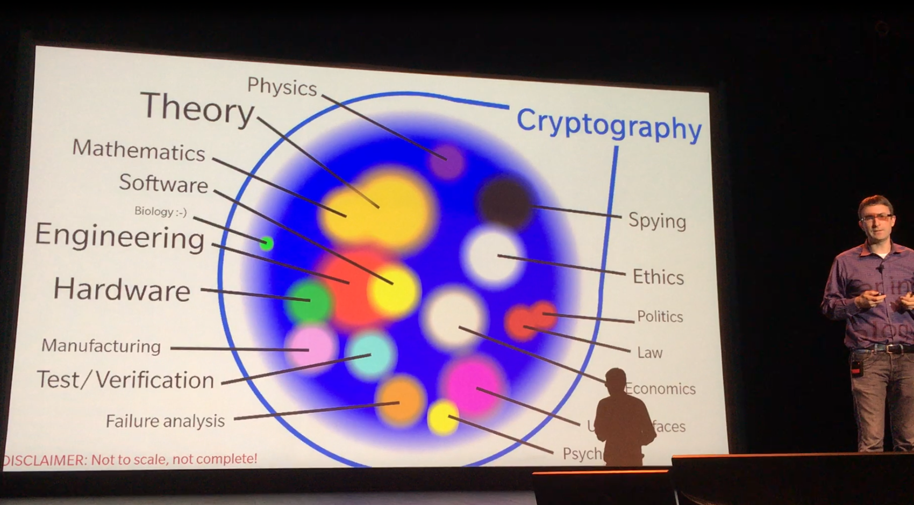
Paul Kocher, Joint invited talk with CRYPTO, CHES 2016 http://www.chesworkshop.org/ches2016/presentations/CHES16_invited.pdf

Slide 91
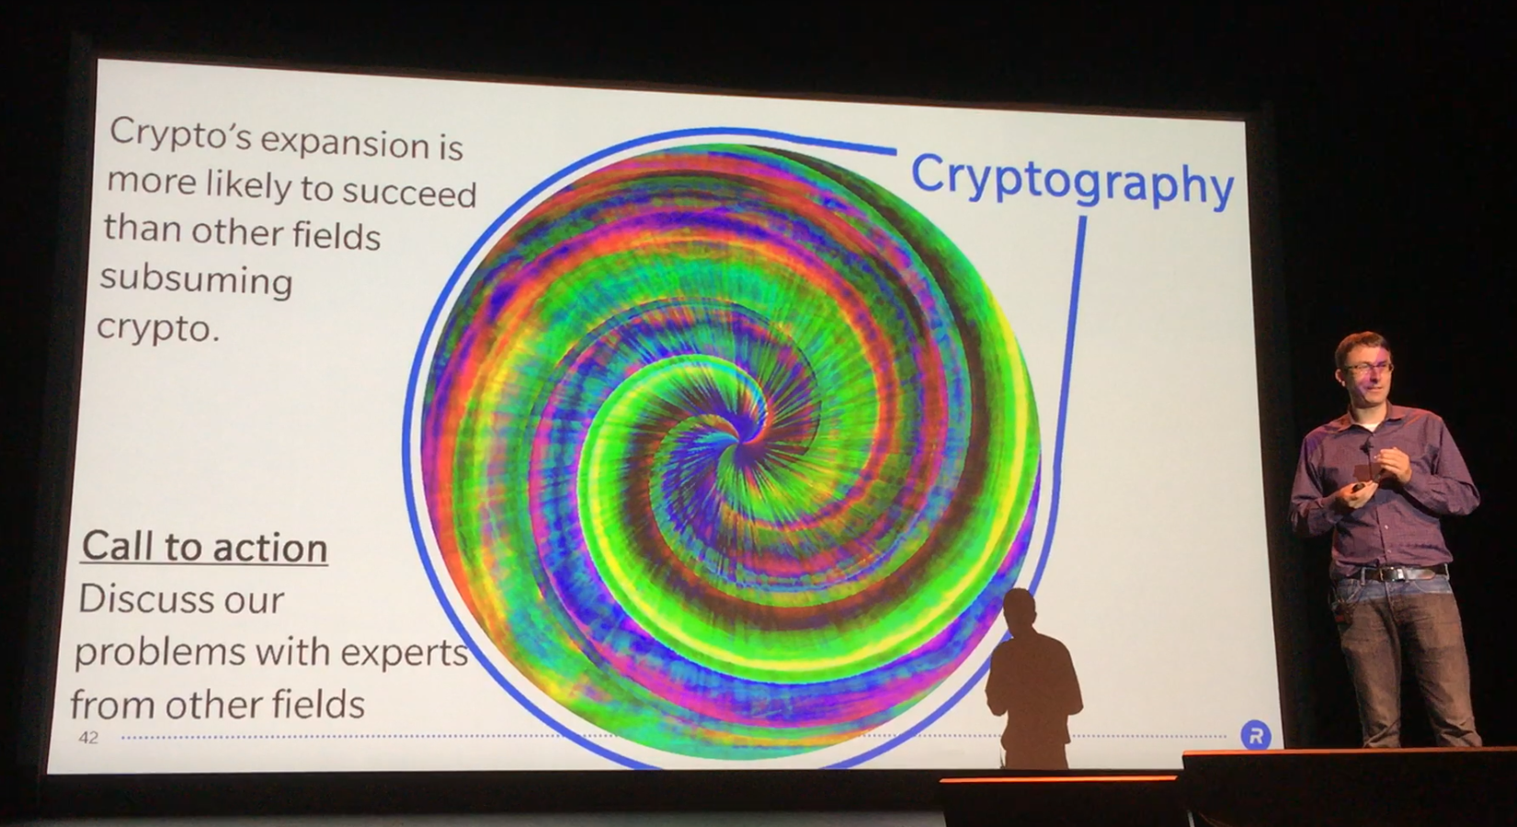
Paul Kocher, Joint invited talk with CRYPTO, CHES 2016 http://www.chesworkshop.org/ches2016/presentations/CHES16_invited.pdf
Paul Kocher, Joint invited talk with CRYPTO, CHES 2016 http://www.chesworkshop.org/ches2016/presentations/CHES16_invited.pdf

Slide 92


How to Start…..
Kung Fu Hustle, https://en.wikipedia.org/wiki/Kung_Fu_Hustle

Slide 93
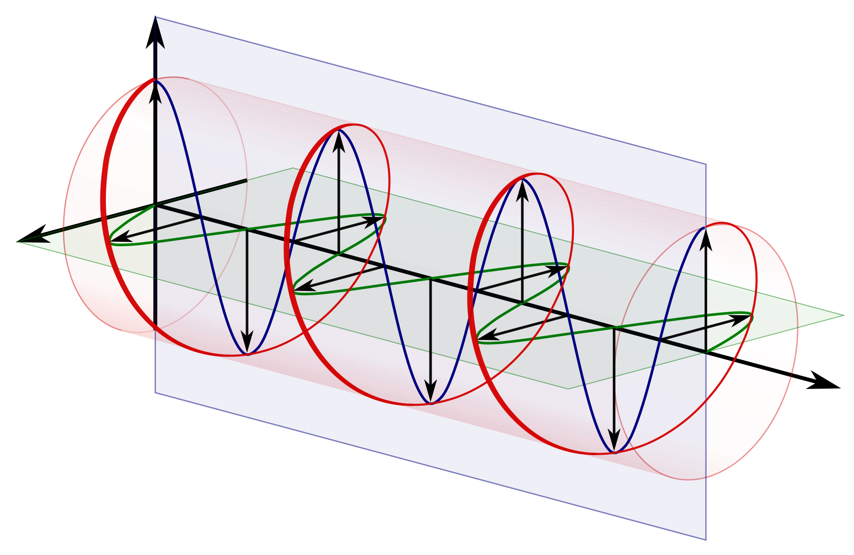
Conclusion
Right-Hand Circular Polarization, RHCP
Verification or Penetration test
Attack or Analysis
Defense or Countermeasure

